Slide 1
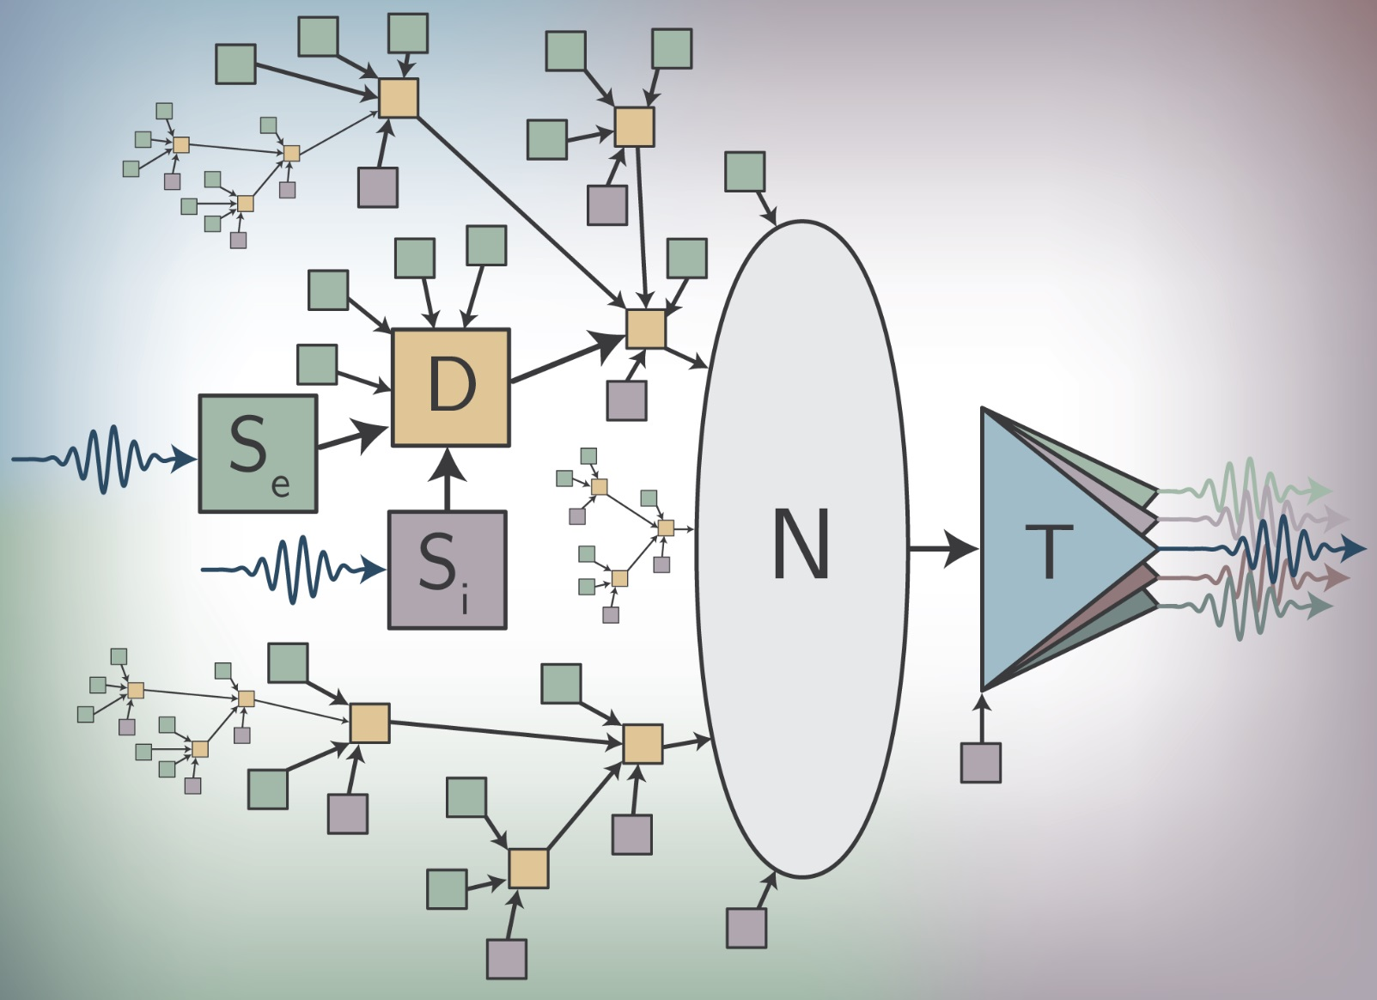
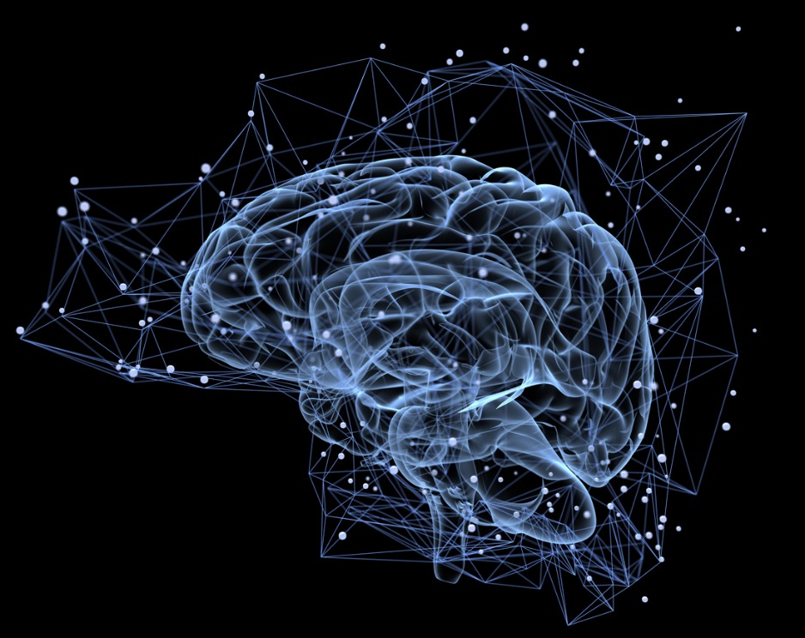
Superconductors, light, and the “age of of cognition”
“Super” Neuromorphic Computing with Photonic and Superconducting Devices
Jeff Chiles, Sonia Buckley, Adam McCaughan, Saeed Khan, Bryce Primavera,
Rich Mirin, Sae Woo Nam, Jeff Shainline
NIST, Physical Measurement Laboratory

Slide 2
High Performance Single Photon Detectors
Superconducting nanowire single photon detector
Superconducting Transistion-Edge Sensors
Microwave Kinetic Inductance Detectors
Conventional Applications
Advanced sensors for astronomy and astrophysics
High Energy Physics – rare particle event searches
Quantum Information / Quantum Computation

Slide 3

Photonic Quantum Information Requirements
 | Quantum Communication | Quantum Computing (Photonic) | Quantum Computing (atoms) | Entanglement-based random numbers
Wavelength | 1550 nm | Visible, Near-IR | UV | Near-IR
Detection Efficiency | As high as possible | As high as possible | >80% | >67%
Dark / Background counts | As low as possible
Timing jitter | As low as possible
Maximum count rate | As high as possible

Slide 4
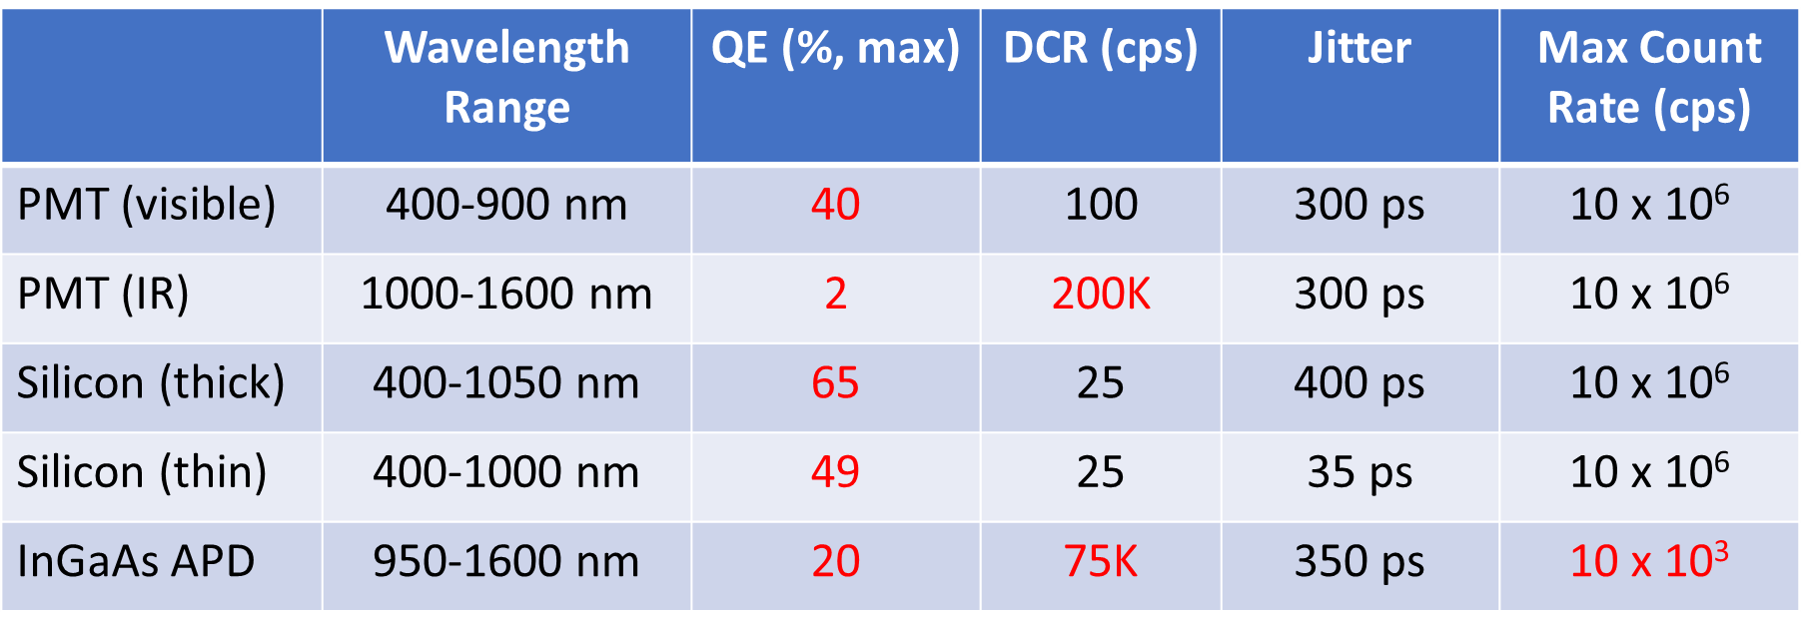
Conventional Single-Photon Detectors
Commercially available
Relatively inexpensive
M. D. Eisaman, J. Fan, A. Migdall, and S. V. Polyakov, Rev. Sci. Instrum. 82, 071101 (2011)

Slide 5
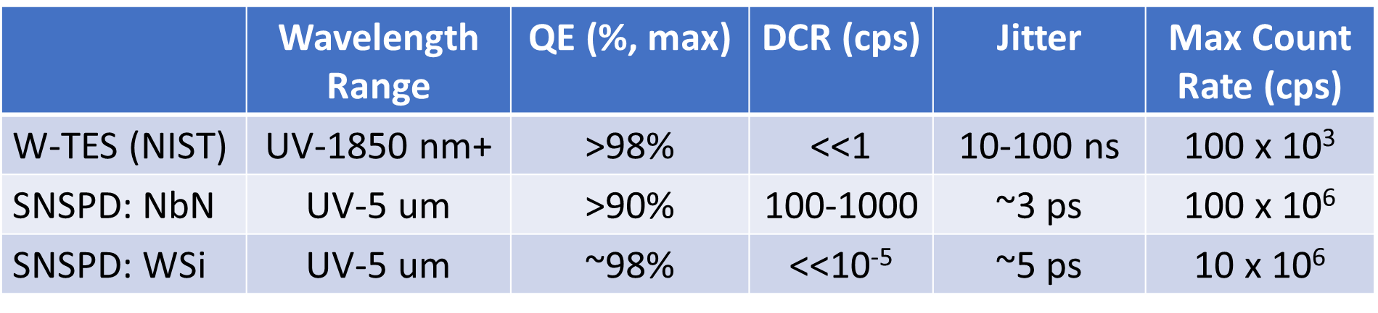
Low Temperature Physics = High Performance
TES: Transition Edge Sensor
SNSPD: Superconducting Nanowire Single Photon Detector
No afterpulsing problems
Excellent prospects for longer wavelengths

Slide 6
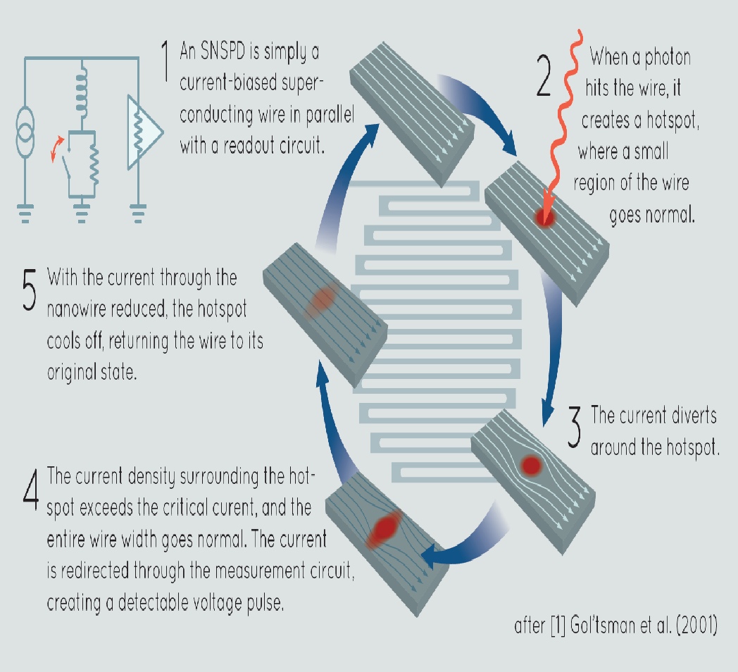
Superconducting Nanowire Single Photon Detectors:
ultra-thin (2nm to 8nm)
Anomolous kinetic inductance
NbN, NbTiN
2K operating temperature
~80nm wide
New materials:
W-Si, Mo-Si, Mo-Ge
1K operating temperature
~150nm
5 microns wide

Slide 7
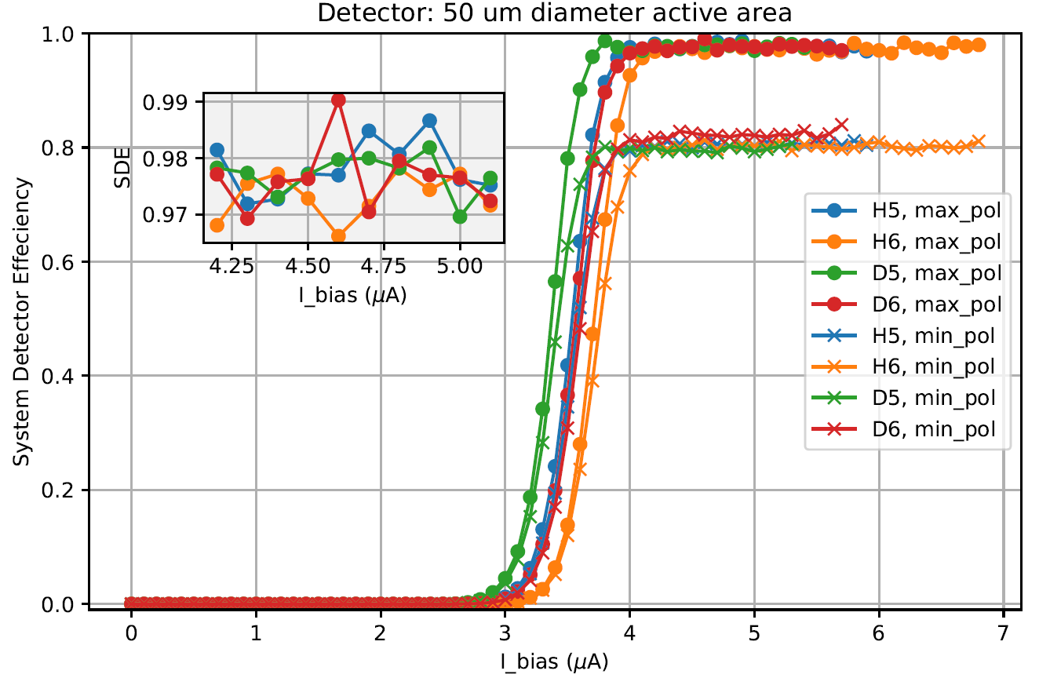
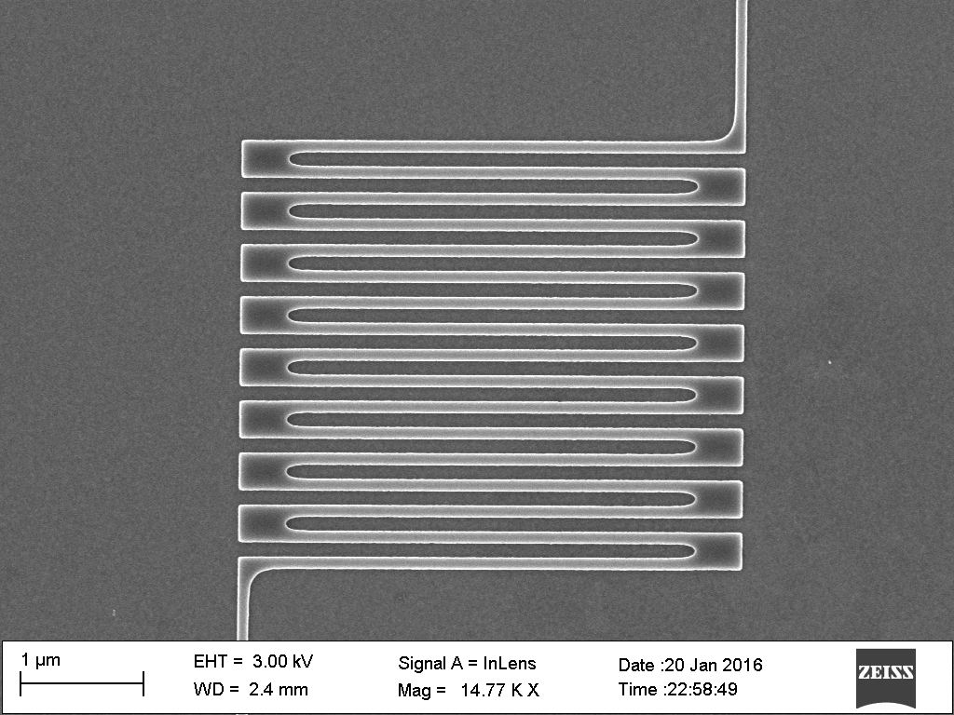
Simplicity of Superconducting Nanowire Single Photoncs Detectors
Bias versus Efficiency / counts
X
Simple Readout

Slide 8
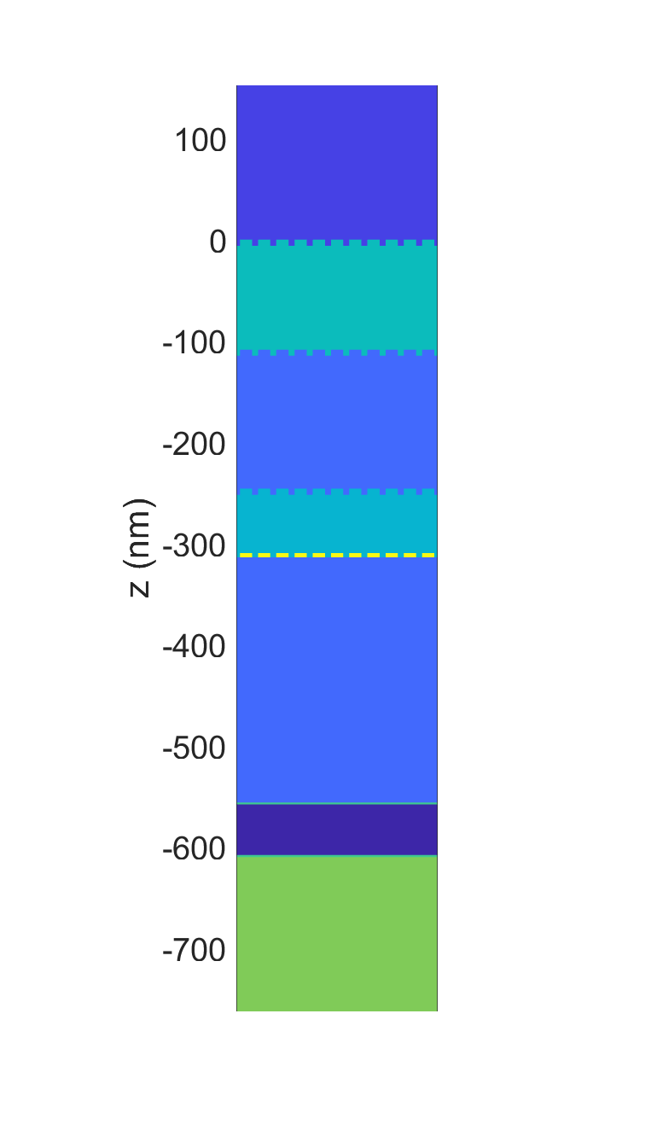
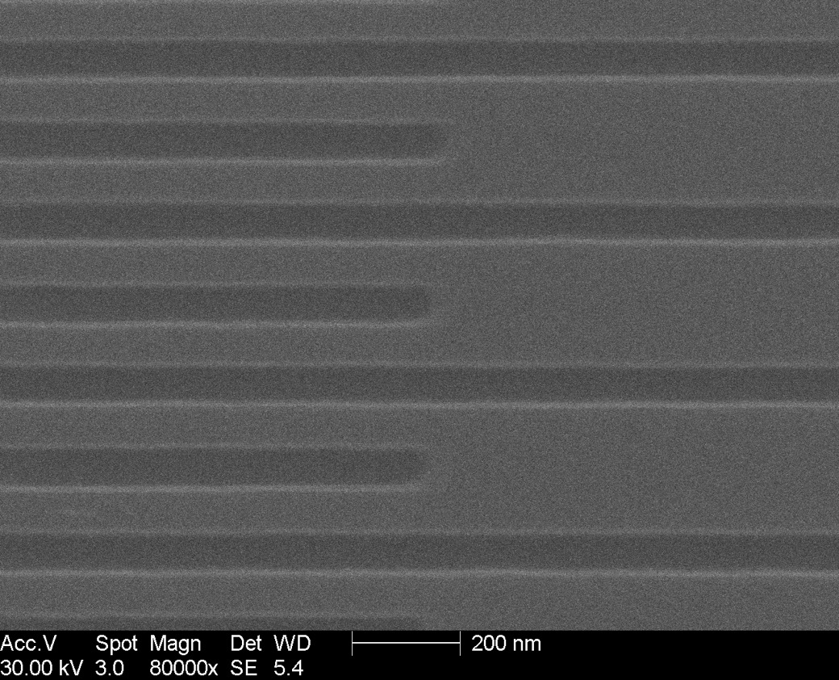
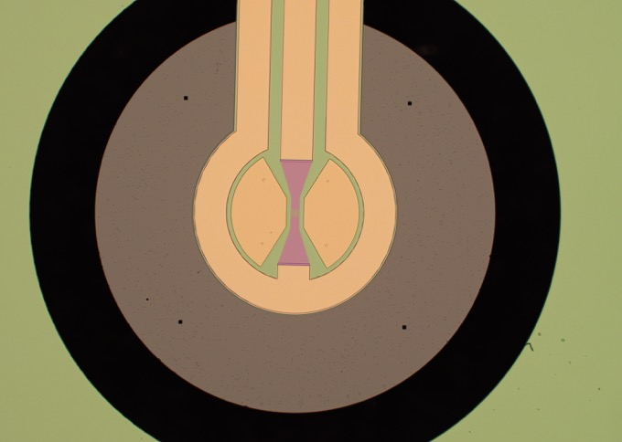
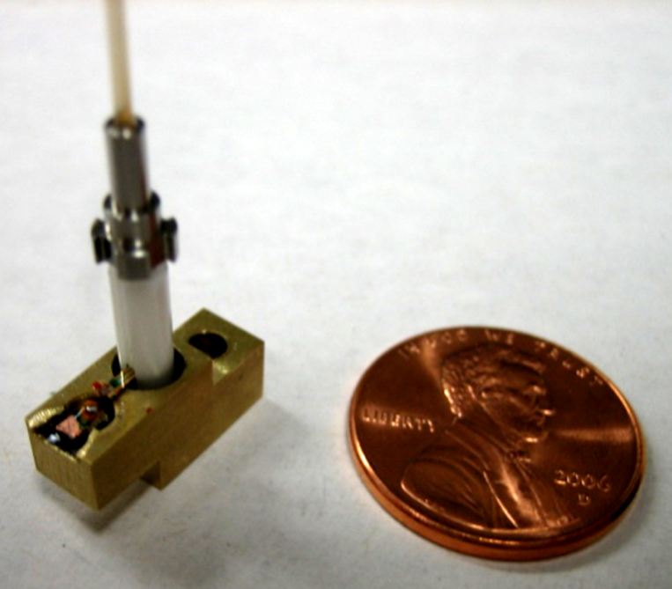
Single Pixel Devices
2.5 mm
Incoming photons
100 nm
Air
aSi
60 nm
SiO2
aSi
SiO2
Au
Substrate
Available Commercially now !!!
Notes:
8

Slide 9
Future of Computing
High Performance Computing. (HPC)
Traditional model of computation
Quantum Computing and Networking (QC)
Can outperform HPC in some tasks
Neuromorphic Computing (NC)
“Neuroscience” inspired architecture
Dedicated Hardware

Slide 10
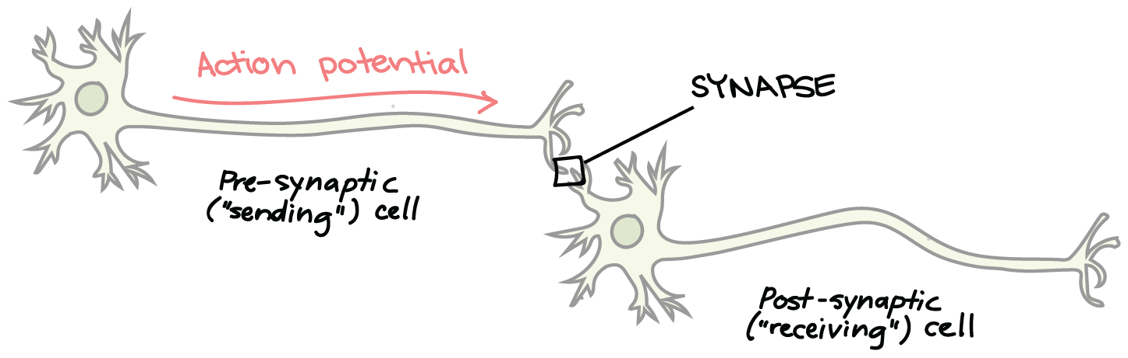
Structure of a Biological Neuron
DENDRITES
From:Wikipedia
https://www.khanacademy.org/science/biology/human-biology/neuron-nervous-system/a/the-synapse
http://spie.org/news/5681-dendritic-plateau-potentials-modulate-neuronal-function?SSO=1

Slide 11

Fast Introduction to Neural Networks
Artificial Neuron
Network of Neurons
b
w₁
x₁
inputs
w₂
Σ
x₂
F(x)
w₃
x₃
Summing
Node
Activation
Function
Synaptic
Weights
Input Cell / Layer
Hidden Cell / Layer
Output Cell / Layer
http://www.asimovinstitute.org/neural-network-zoo/

Slide 12


Supervised Learning
Untrained
Neural Network
Training
Trained
Neural Network
Inference
New
Data
not
cat
cat
✓
✓
✅

Slide 13
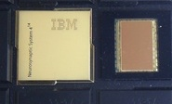

Machine learning hardware
Today, there is large demand to perform “neural network” operations
Image Classification
Speech Recognition
Natural Language Processing: “translation”
Dedicated Neuromorphic Hardware
Other Technology platforms Neuromorphic have attracted venture interest
TrueNorth, IBM
see Merolla et al.,
Science, 2011.
Bill Gates
Notes:
Plug Nick’s talk
I don’t have to make a case that Moore’s law is ending. There is a belief that electronics will not be able to supply what is needed – nothing is on the way. This was not true in 1980s. GPUs and FPGAs

Slide 14
2nd and 3rd Generation Neural Networks
2nd Generation: “Proven”
Limited Biological “inspiration”
Matrix-vector multiplication
Seeking weight matrix
Trained by supervisory system
Limited History
Task specific
3rd Generation: “Less Proven”
More Biologically inspired
Information in dynamical state
Spiking neurons communicate in rate and timing
Potential for learning without supervision
Information integrated across space and time
General cognitive systems

Slide 15
Question: Why do we need Generation 3? Answer: Energy Efficiency and Size
“How do you make the largest scale artificial neural network?”
Human Brain:
10 billion neurons
1 neuron fans out to 10,000 neurons
What are the fundamental limits?
How do you evaluate the performance?
How do physical characteristics of the devices relate to the performance of the neuromorphic computer?
https://arxiv.org/abs/1906.02243v1

Slide 16
Spiking Neural Networks / Dedicated Hardware
Biologically Inspired
Spiking Signals, Energy Efficient
Rate and Time encoding
Differentiated local processing
Information integration across:
Space (network structure)
Time (dynamics)
Experience (plasticity)
Can we get to a size scale for “Cognitive” Systems?

Slide 17
Energy and Training Targets
Power
2500 kCal/day = 100Watts
Clock speed
1 Hz to 1kHz
Training time
18 years
Human
Power
100 kW to 1 MW
Clock speed
1 Mhz to 10MHz
Training time
1 week
Artificial
Notes:
Dominated by light source
1fJ is needed per synapse
10^10 neurons * 10^4 connections * 1fJ / 10^-4 efficiency of the source = 10^3 Joules
10^6 clockspeed * 10^-3 utilization (not all neurons firing at once) = 1Mwatt

Slide 18
Energy estimates
10^10 neurons
10^10 * 10^4 connections
10^10 * 10^4 * 10^5 photons
10^19 photons * 10^4 inefficiency
10^23 photons = 10^23 eV = 10^4 J
1fJ = 1e-15J = 10 photons

Slide 19
Fluxonic processing of photonic synapse events
Spiking neural networks
jeffrey.shainline@nist.gov

Slide 20
Fluxonic processing of photonic synapse events
Light for communication

Slide 21
Fluxonic processing of photonic synapse events
Superconducting electronics for single-photon detection

Slide 22
Fluxonic processing of photonic synapse events
Superconducting electronics for neural computation

Slide 23
Fluxonic processing of photonic synapse events
Neuromorphic supercomputing

Slide 24
Device requirements for massive connectivity
Dense local fanout
Long-range connectivity
We seek very large systems
Energy efficiency is paramount
Principal conjecture:
Use light for communication
Photons don’t have charge or mass
Use single-photons for communication

Slide 25
Neurons that signal with single photons

Slide 26
Neurons that signal with single photons
How do they work?

Slide 27

Superconducting loop

Slide 28
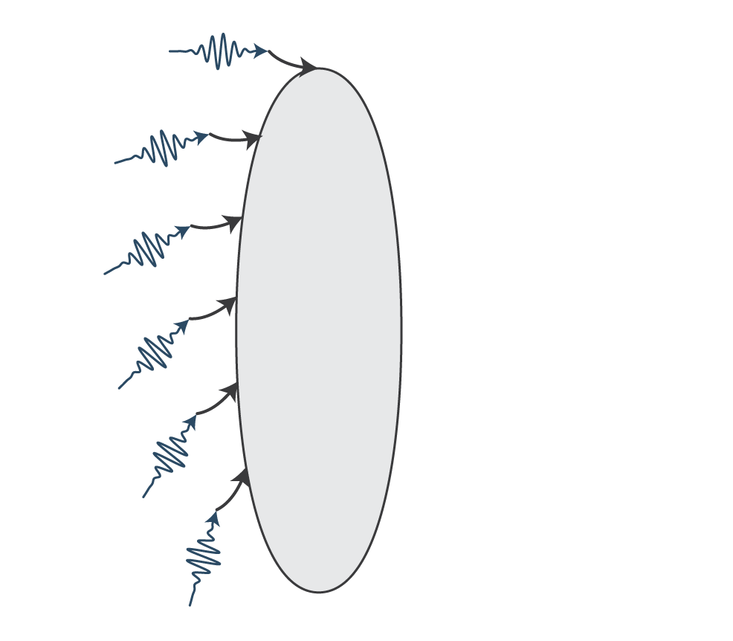
Photons add current

Slide 29
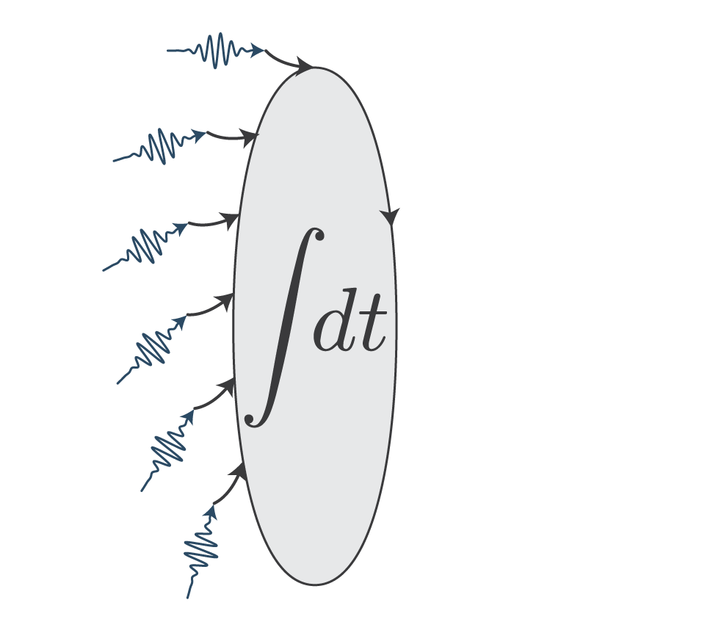
Current gets integrated

Slide 30
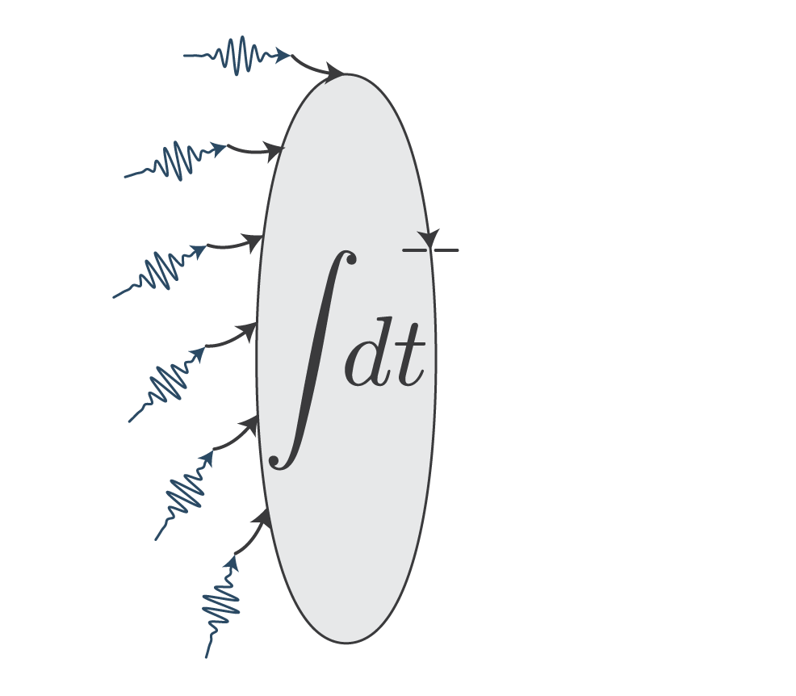
Current threshold

Slide 31

Current threshold

Slide 32
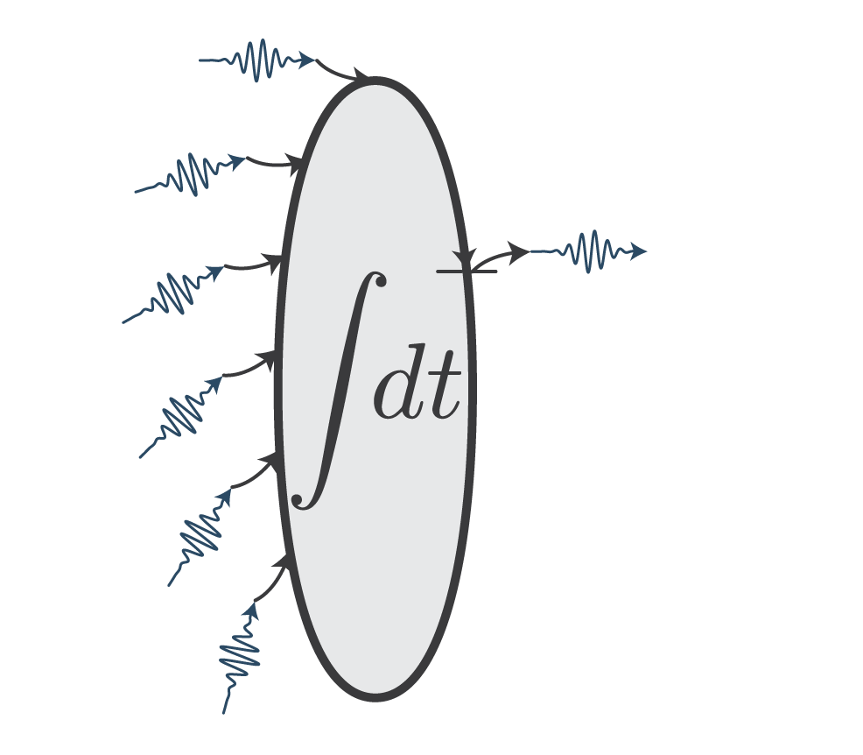
Photons produced

Slide 33
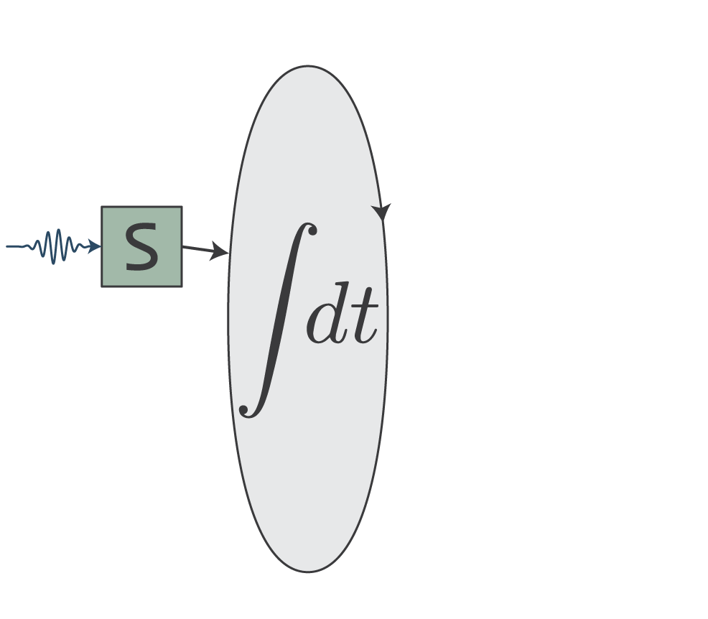
Synapse transduces

Slide 34
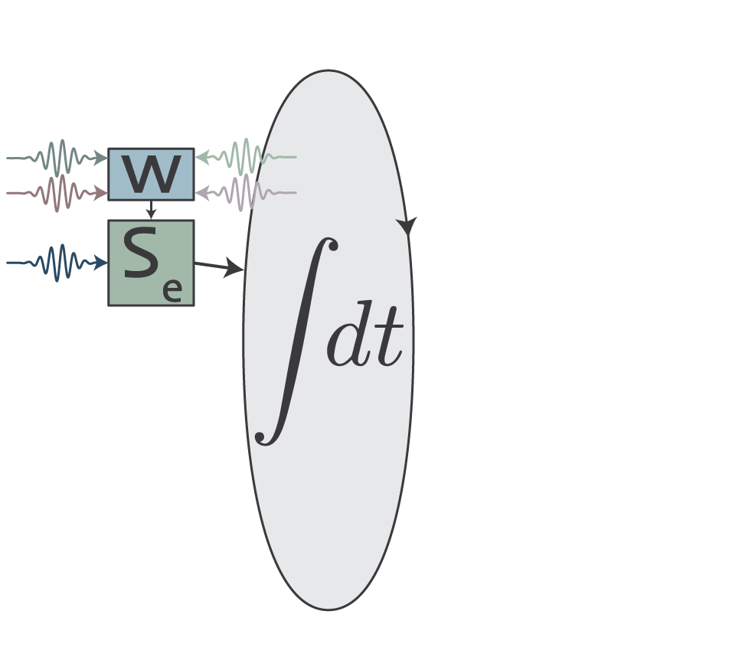
Photons update weight

Slide 35
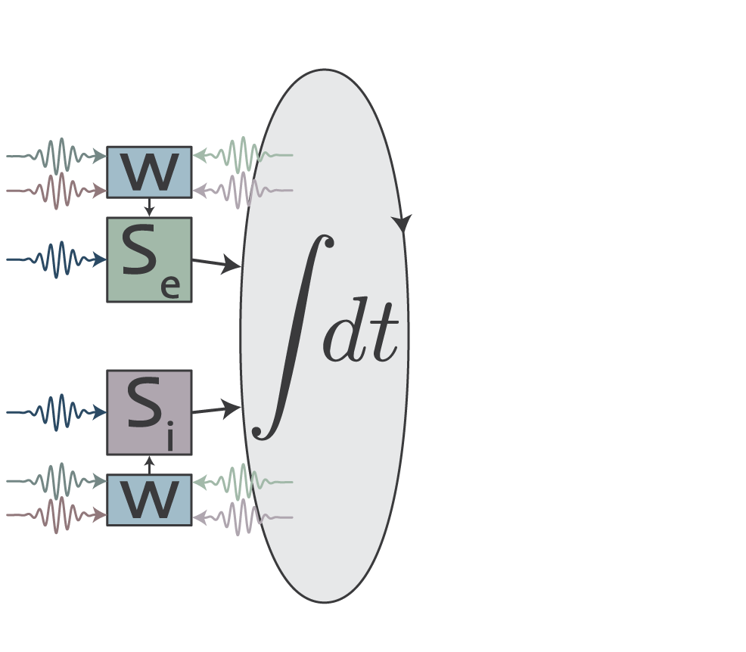
Inhibitory synapses

Slide 36
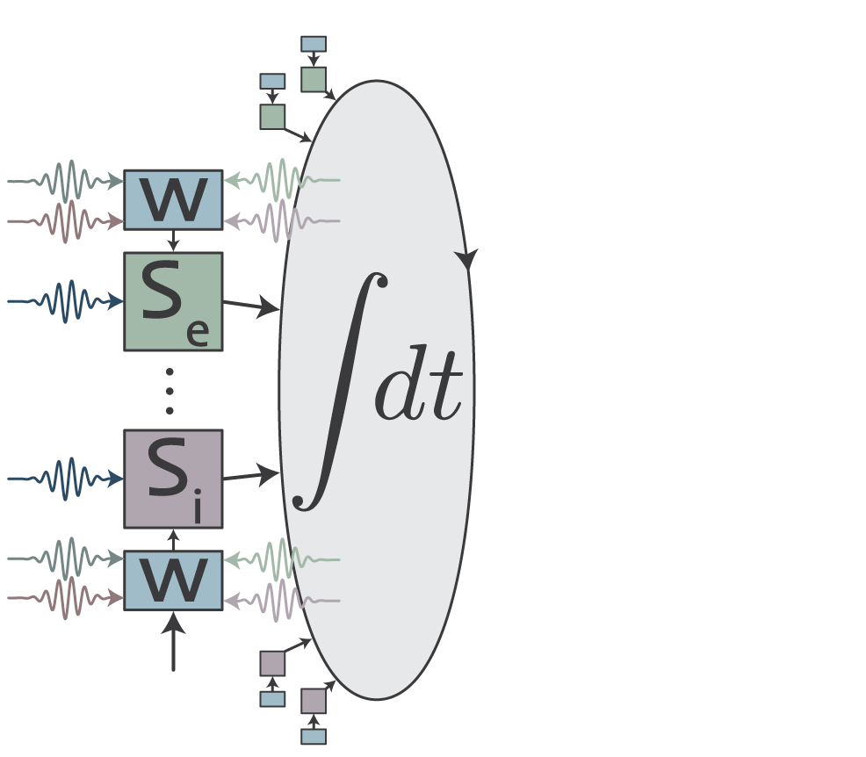
Many synapses

Slide 37
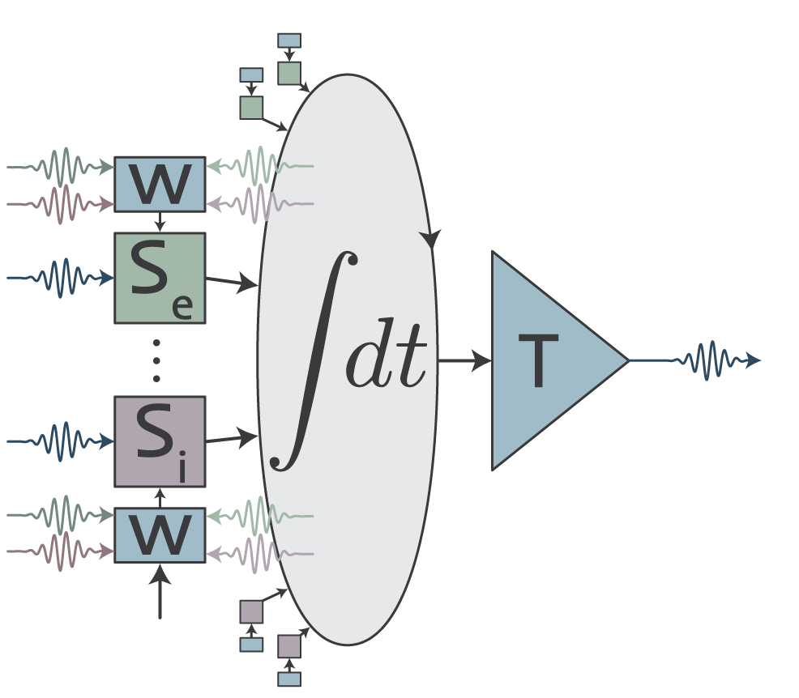
Transmitter circuits

Slide 38
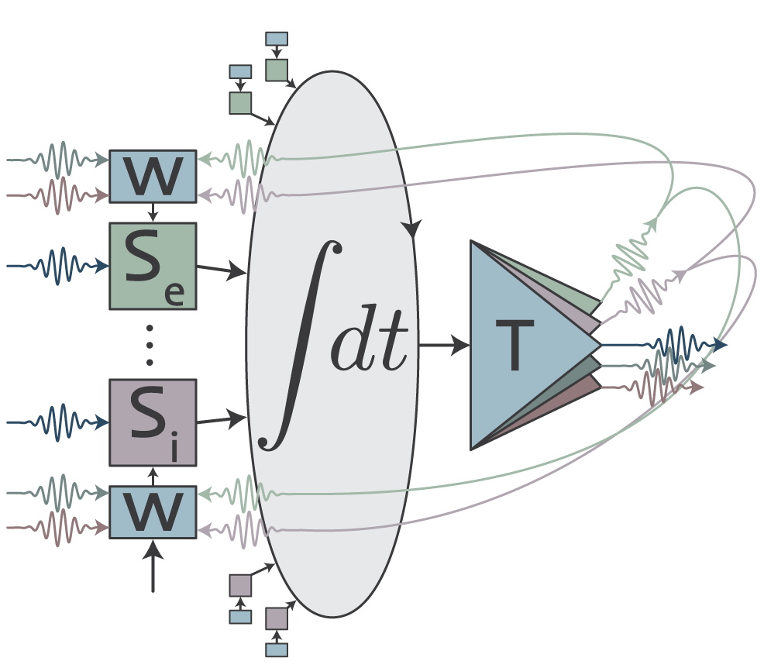
Colors for different operations

Slide 39


Slide 40


Slide 41
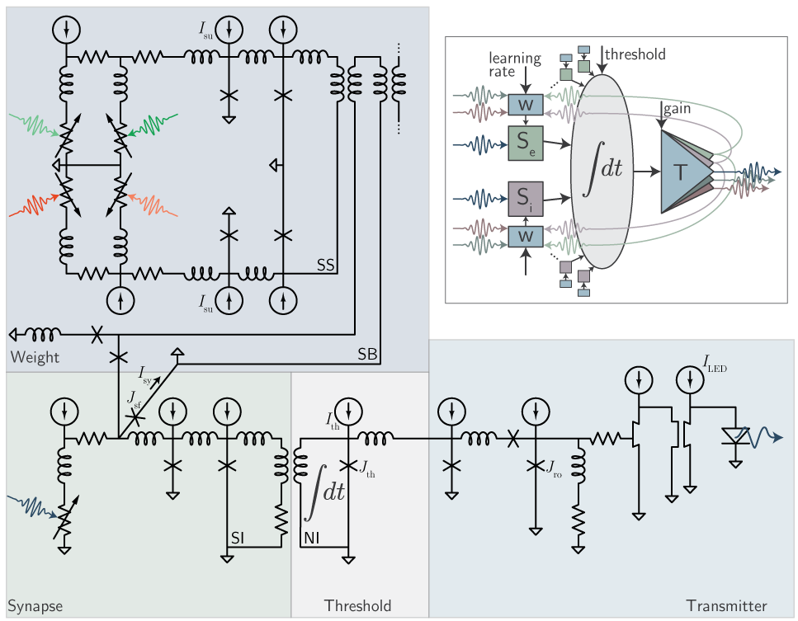
Loop neuron
Shainline et al., arXiv:1805.01929 (2018).
Shaineline, arXiv:1904.02807 (2019)

Slide 42
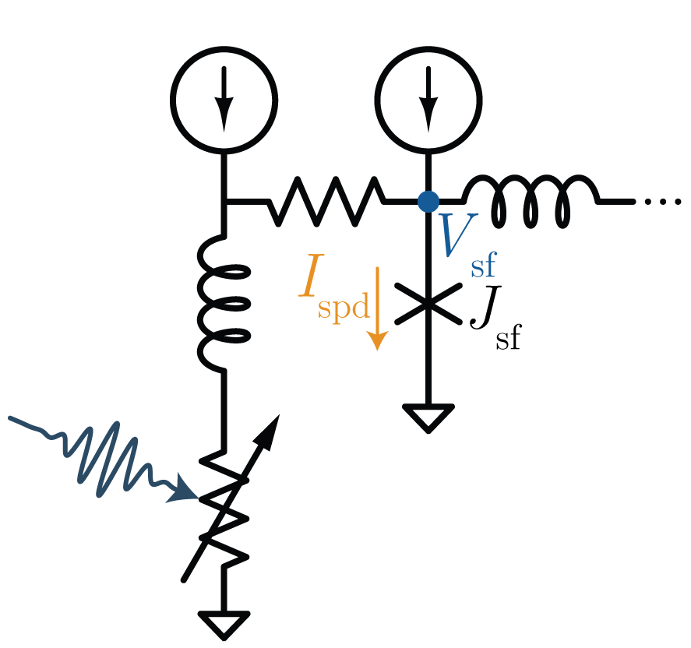
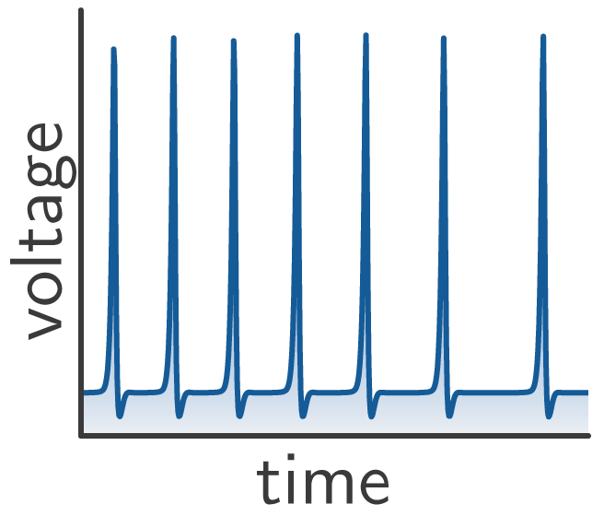
Photon-to-fluxon transducer
these are fluxons

Slide 43
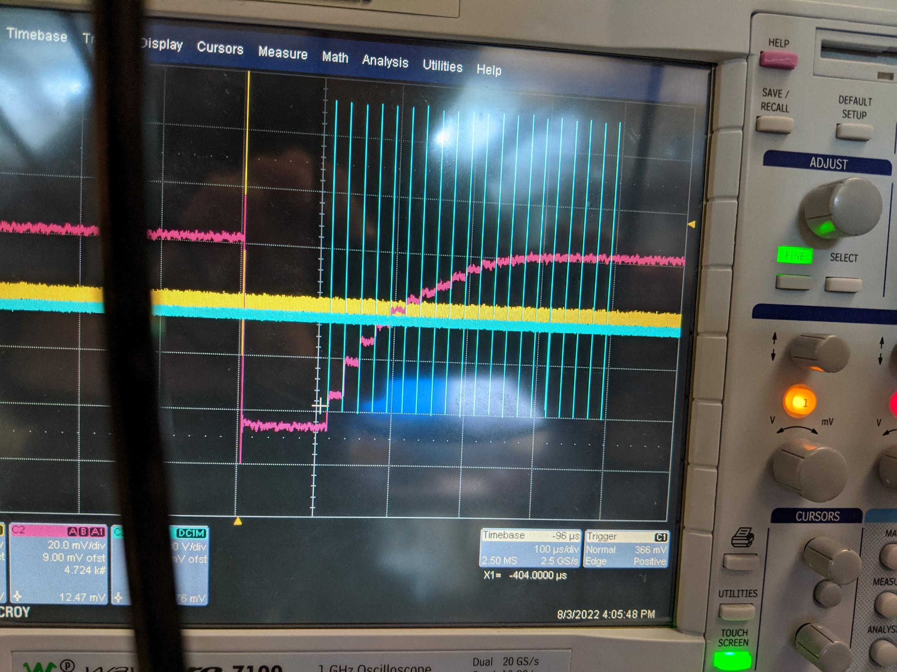
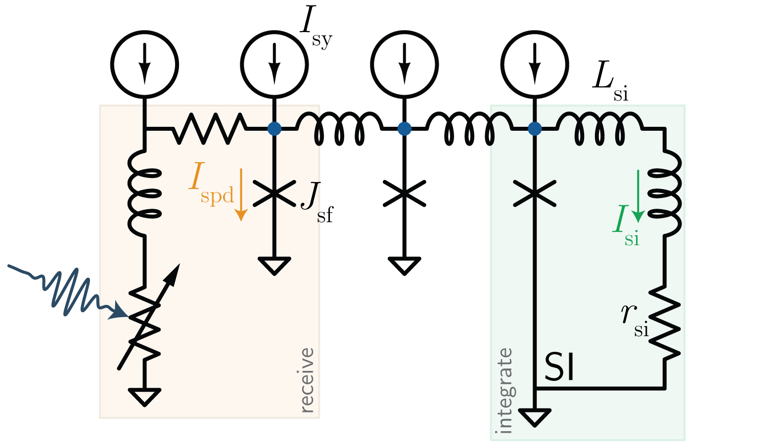
The synapse

Slide 44
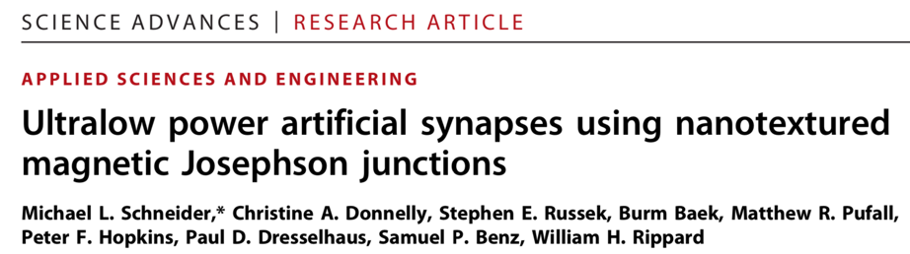
Long-range = photons
Short-range = electronics / SFQ
Pulsed neural networks consisting of single-flux-quantum spiking neurons
T. Hirose, T. Asai, and Y. Amemiya
Physica C, 463:1072, 2007.
https://arxiv.org/abs/1907.00263
A Power Efficient Artificial Neuron Using Superconducting Nanowires
Emily Toomey, Ken Segall, Karl Berggren

Slide 45
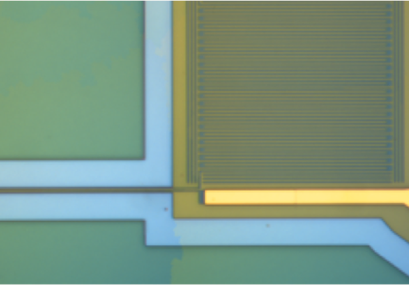
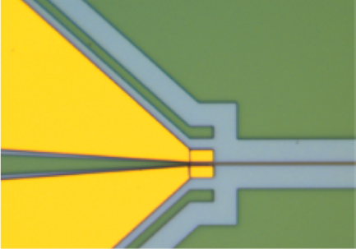
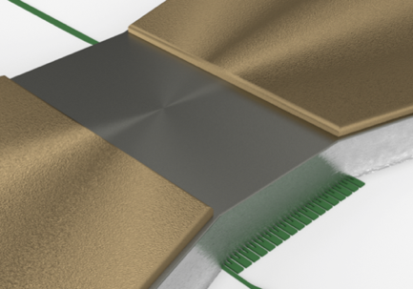
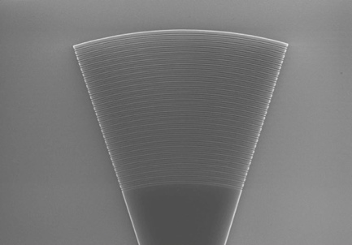
SOEN technical approach superconducting optoelectronic networks
1.
Single photons for minimum spike energy
(superconducting single-photon detectors )
2. Cold optoelectronics for monolithic integration
(all-silicon light-emitting diodes)
3. Cold electronics (SFQ) for nonlinear processing
(Josephson junctions, cryotron switches)
4. Light for interconnects
(silicon photonics)
2.
3.
4.
J. M. Shainline, S. M. Buckley, R. P. Mirin, and S. W. Nam, “Superconducting optoelectronic circuits for neuromorphic computing,” Phys. Rev. Applied, Mar 2017.
Notes:
Accepting to work at cryogenic temperatures means other devices become available

Slide 46
cryogenic silicon photonics platform: recent results

Slide 47
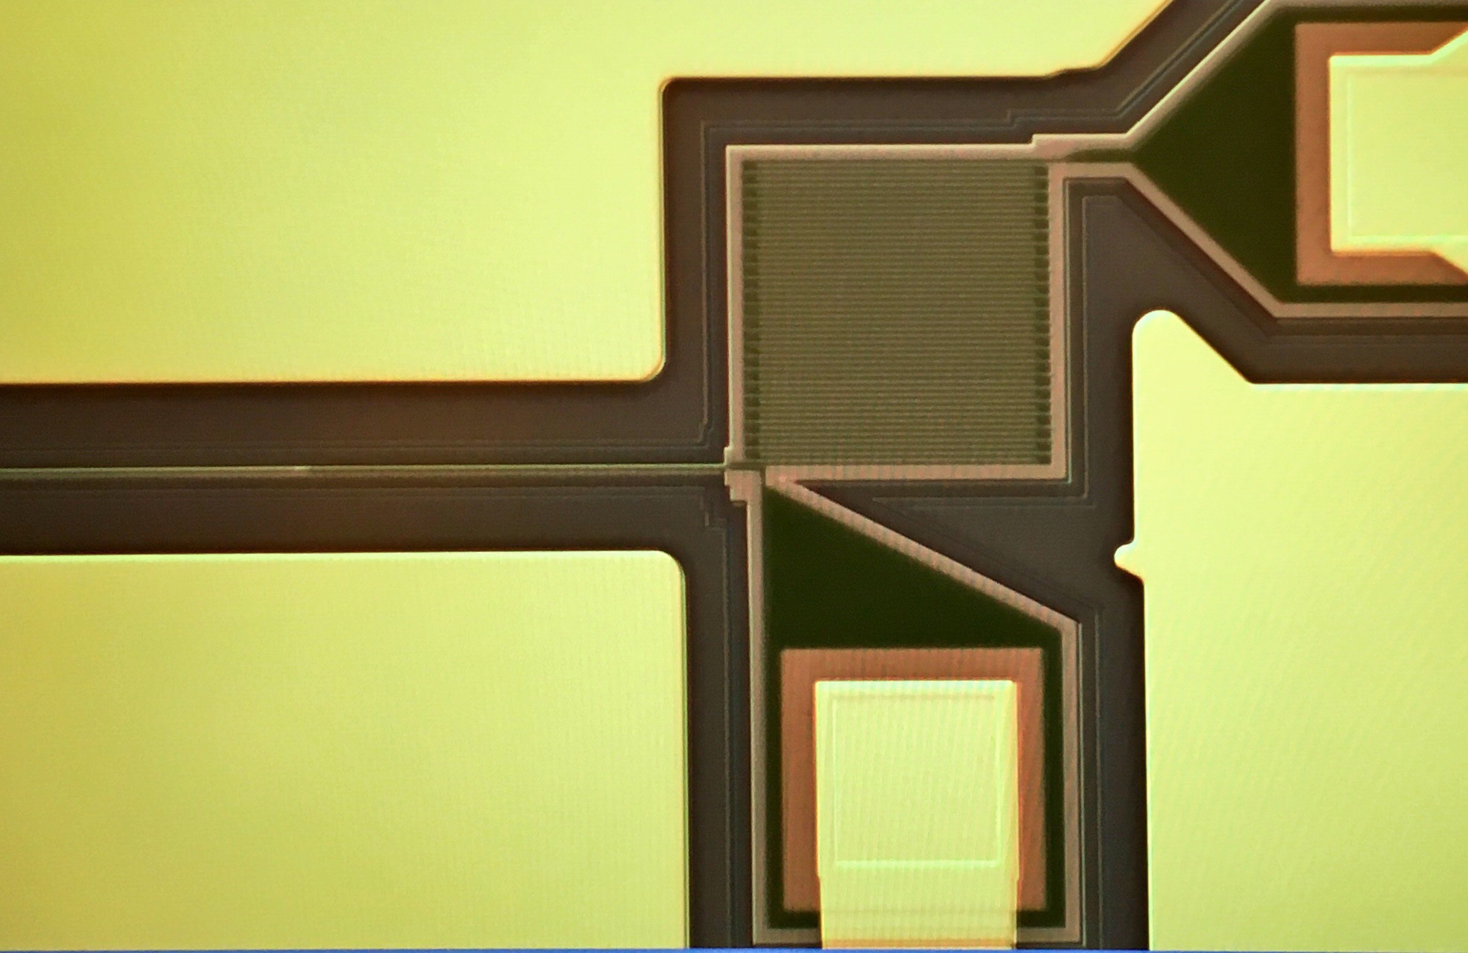
Superconducting Nanowire Detector
single photon
5 nm
160 nm
Nanowire on waveguide
Waveguide

Slide 48
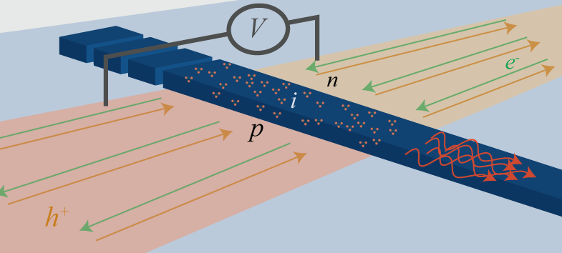
All-silicon light emitting diodes
Si defect centers have optical transitions
Low temp. inhibits non-radiative pathways
Electrical pumping with PN junction
W-centers: 1220nm emission
S. M. Buckley et al. “All-silicon light-emitting diodes waveguide-integrated...” APL, 2017.
Notes:
Describe the fabrication briefly

Slide 49
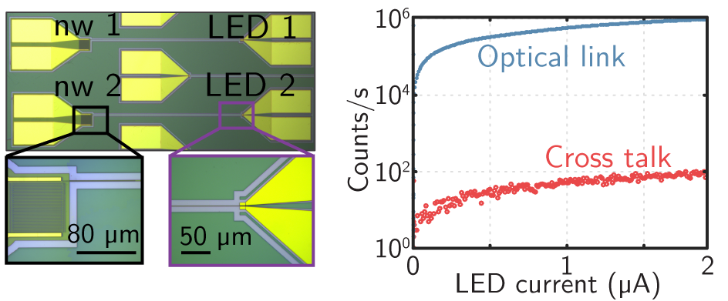
Co-integration: Silicon LEDs + SNSPDs
S. M. Buckley et al. “All-silicon light-emitting diodes waveguide-integrated...” APL, 2017.
Notes:
Say that: since this article, we have enhanced photoluminescence by a factor of 300. Promising results and a paper is in preparation.

Slide 50
All-silicon light emitting diodes
LED turn-on voltage is ~ 1 V
SNSPD can output ~ 1 mV
S. M. Buckley et al. “All-silicon light-emitting diodes waveguide-integrated...” APL, 2017.
Notes:
Describe the fabrication briefly

Slide 51
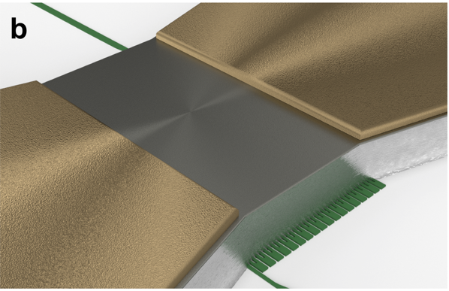
Nano-cryotron thermal switch
millivolt input -> Volt output
No Josephson Junctions needed
Reset about 10ns
A. McCaughan et al. “A compact, ultrahigh impedance superconducting thermal switch for interfacing superconductors with semiconductors and optoelectronics,” arXiv:1903.10461, 2019.

Slide 52
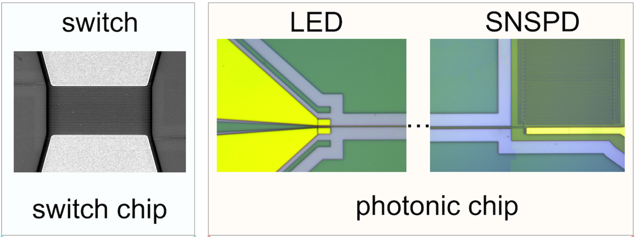
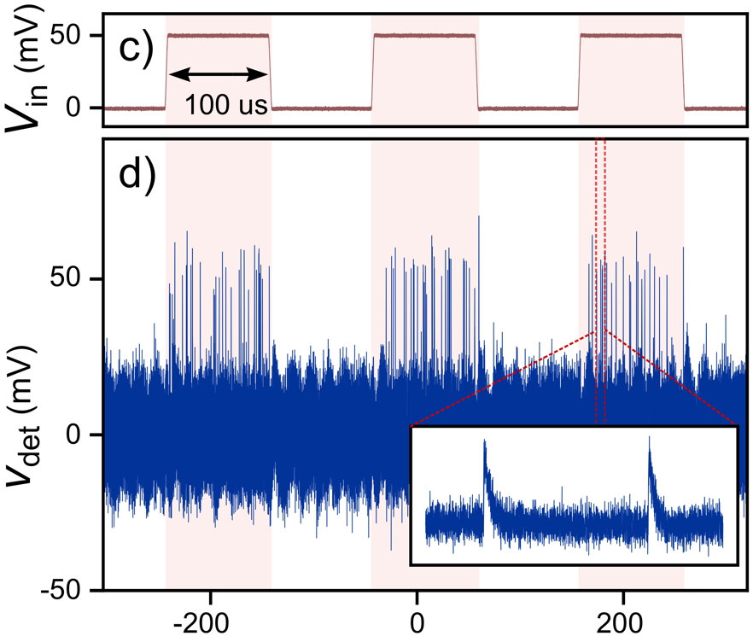
Superconductor-to-semiconductor interface
4.6 us
Time (us)
A. McCaughan et al. “A compact, ultrahigh impedance superconducting thermal switch for interfacing superconductors with semiconductors and optoelectronics,” arXiv:1903.10461, 2019.
Notes:
What points to make about this

Slide 53
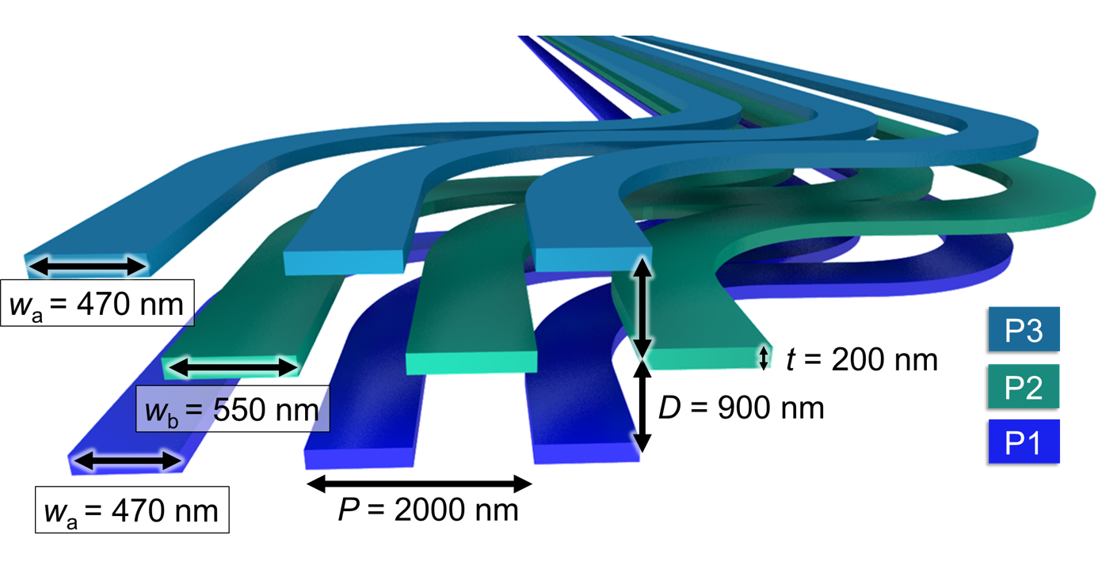
First steps toward photonic networks
Three planes of amorphous silicon waveguides
Chiles et al., APL Photonics 2, 116101 (2017)

Slide 54
Inter-planar couplers
0.05 dB loss
36 μm length
36 μm
Chiles et al, APL Photonics 2 116101 (2017).

Slide 55
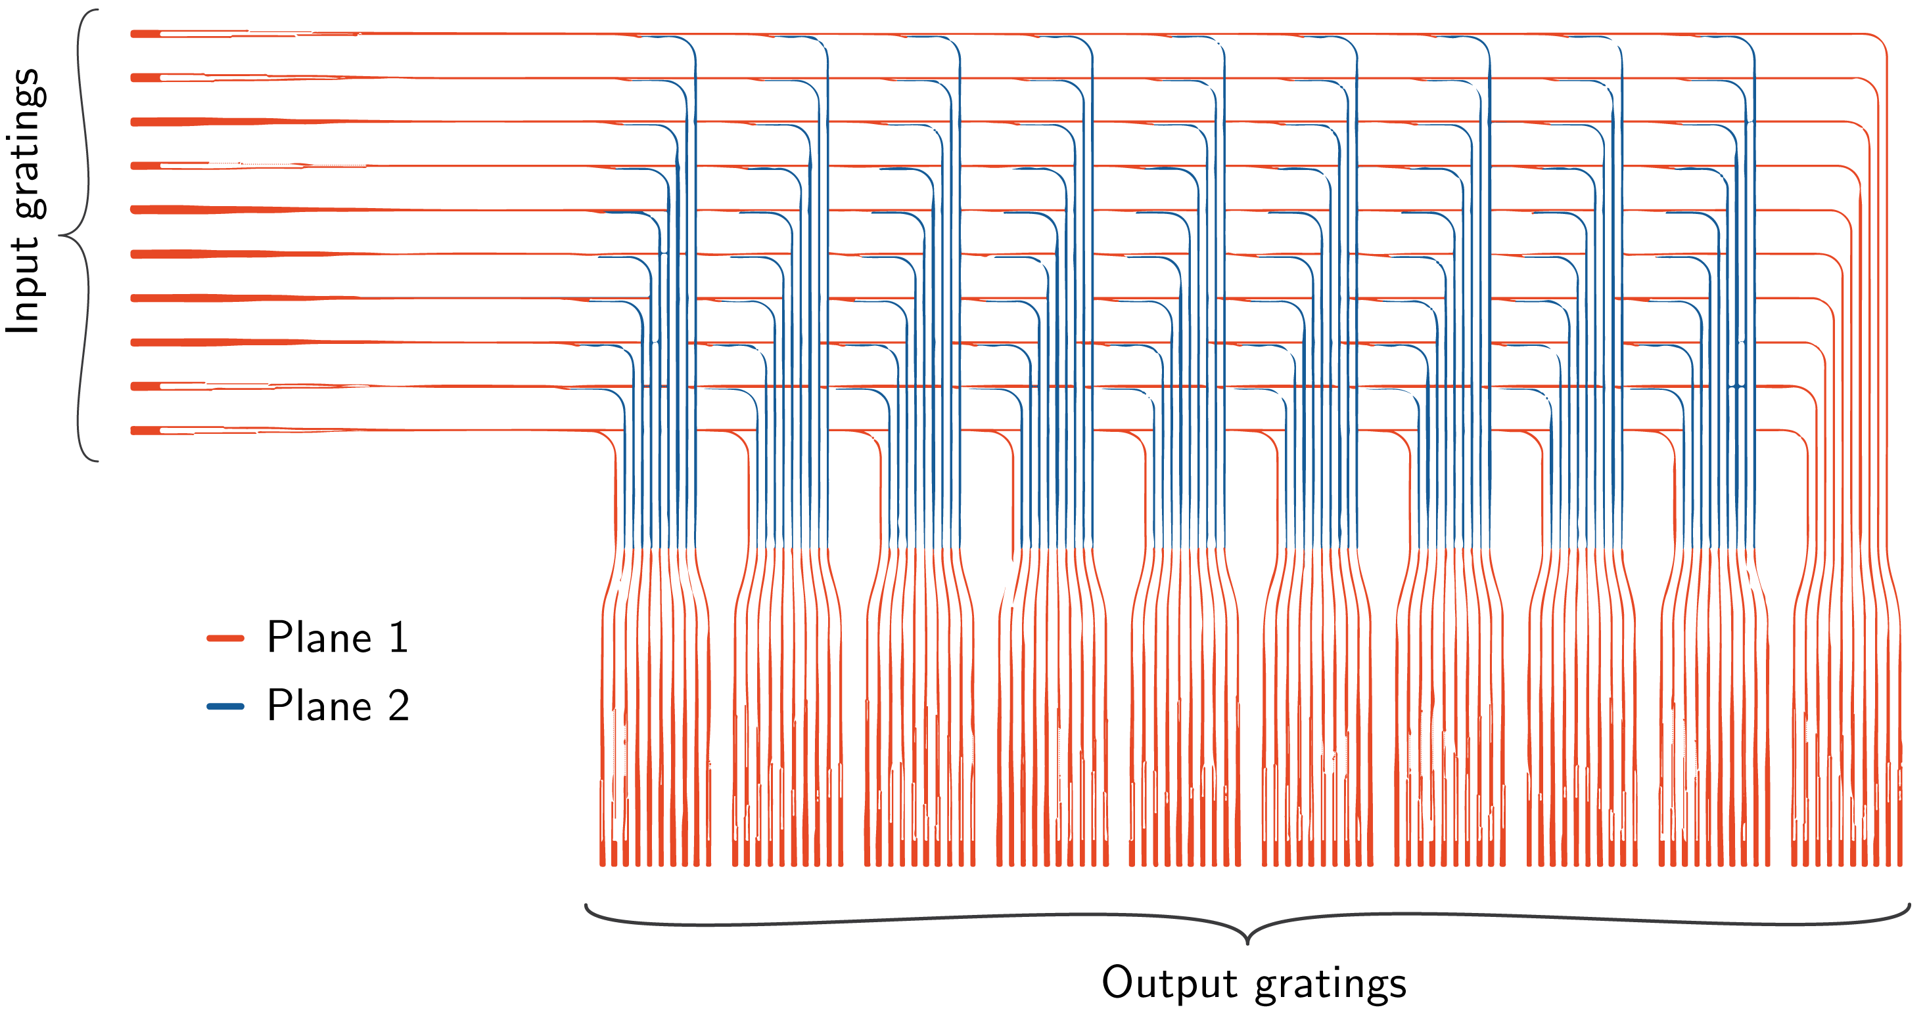
10 x 100 routing couplers
Chiles et al, APL Photonics 3 106101 (2018).

Slide 56
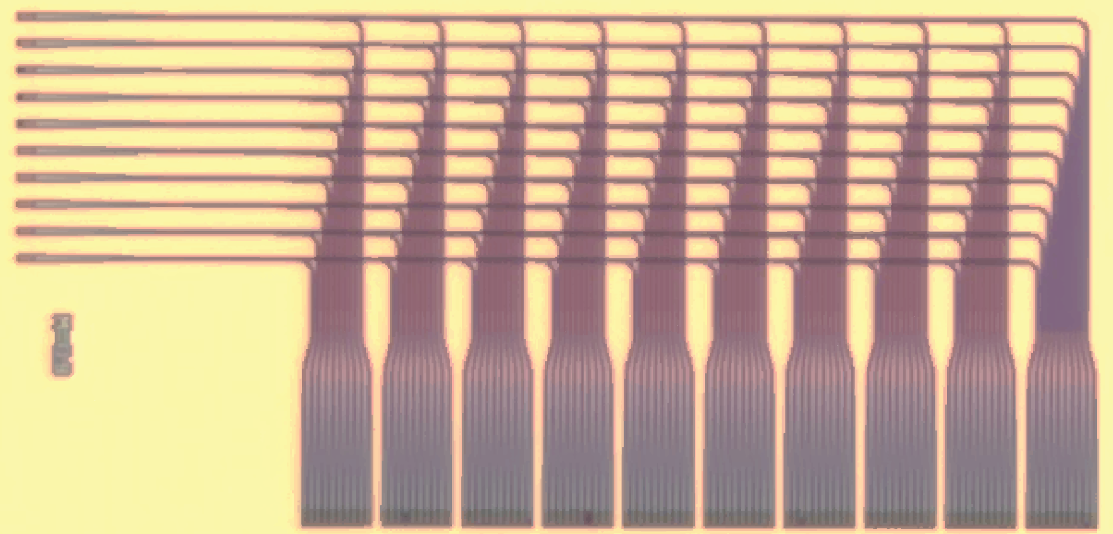

10 x 100 routing couplers

Slide 57
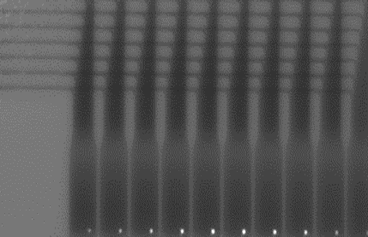

10 x 100 routing couplers

Slide 58
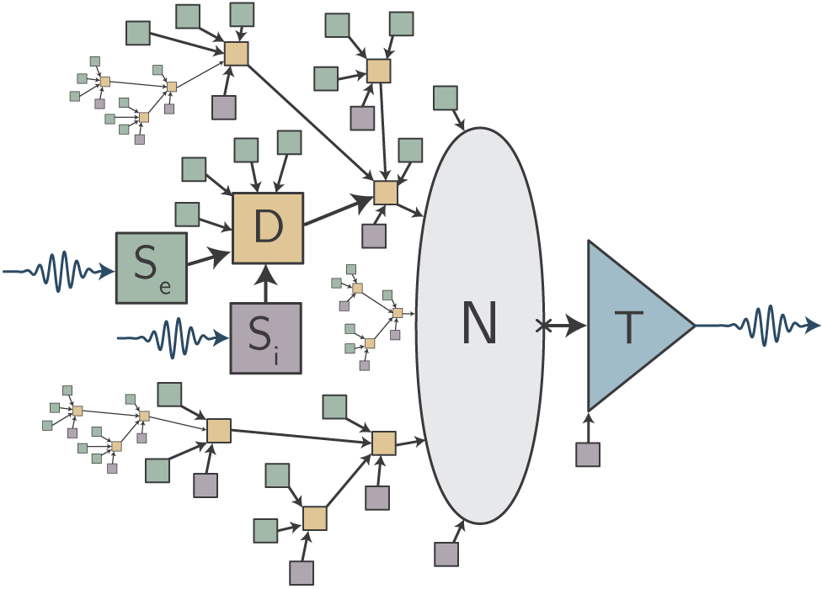
Full Superconducting Optoelectronic Neuron
Josephson
Junction circuits
Superconducting
Switch
SNSPDs
Silicon LED
Optical
Electronic
Electronic
Optical
Fluxonic
J. M. Shainline, “Fluxonic processing of photonic synapse events,” arXiv:1904.02807, 2019.
Notes:
photons are expensive
one circuit multiple purposes (enumerate some)
summing and intermediate processing
Come back to characteristic length. We should pack a bunch of complexity in a small space and make it electronic

Slide 59
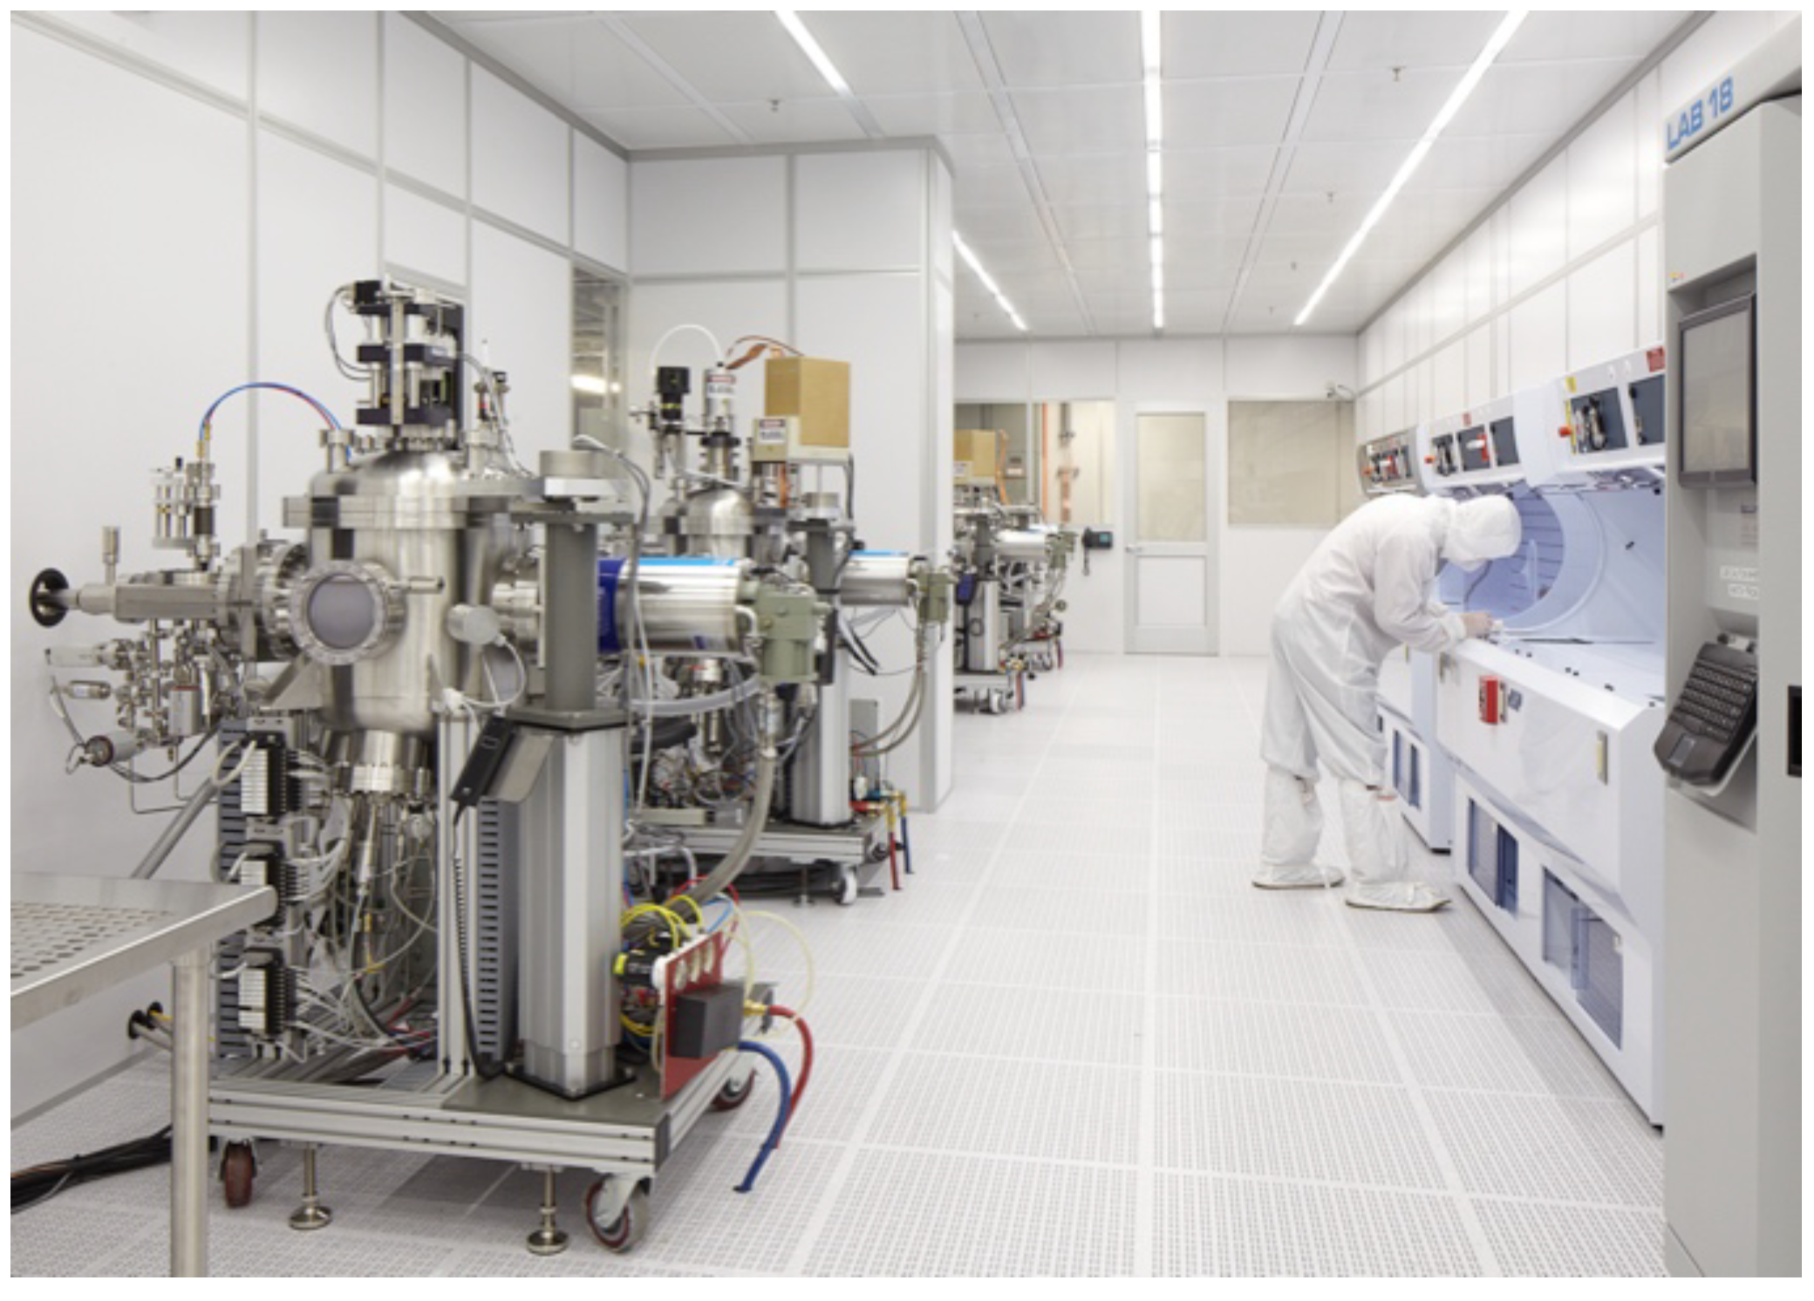
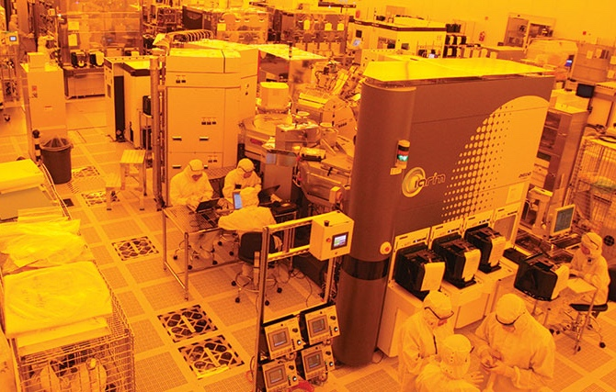
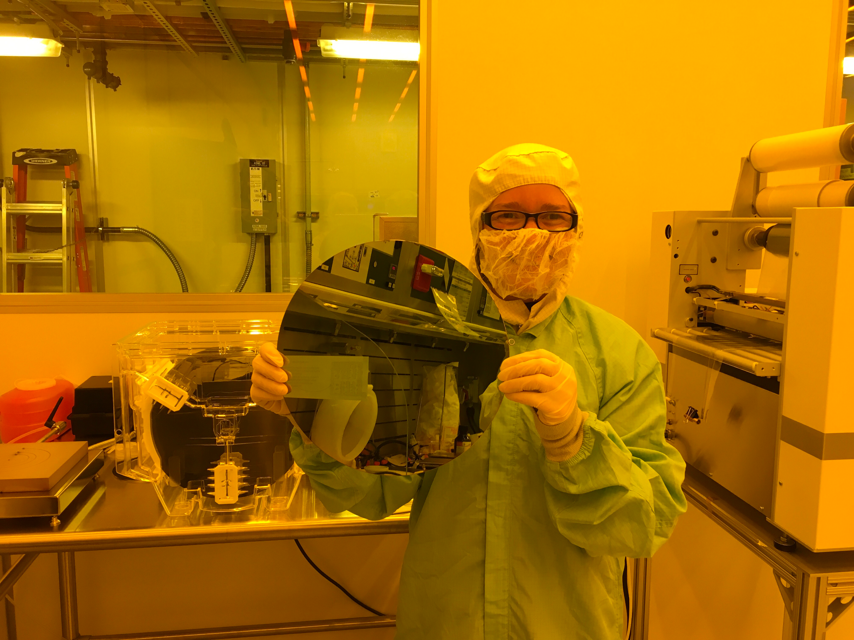
Eventual transfer to 300 mm foundry
Notes:
And for better scale

Slide 60
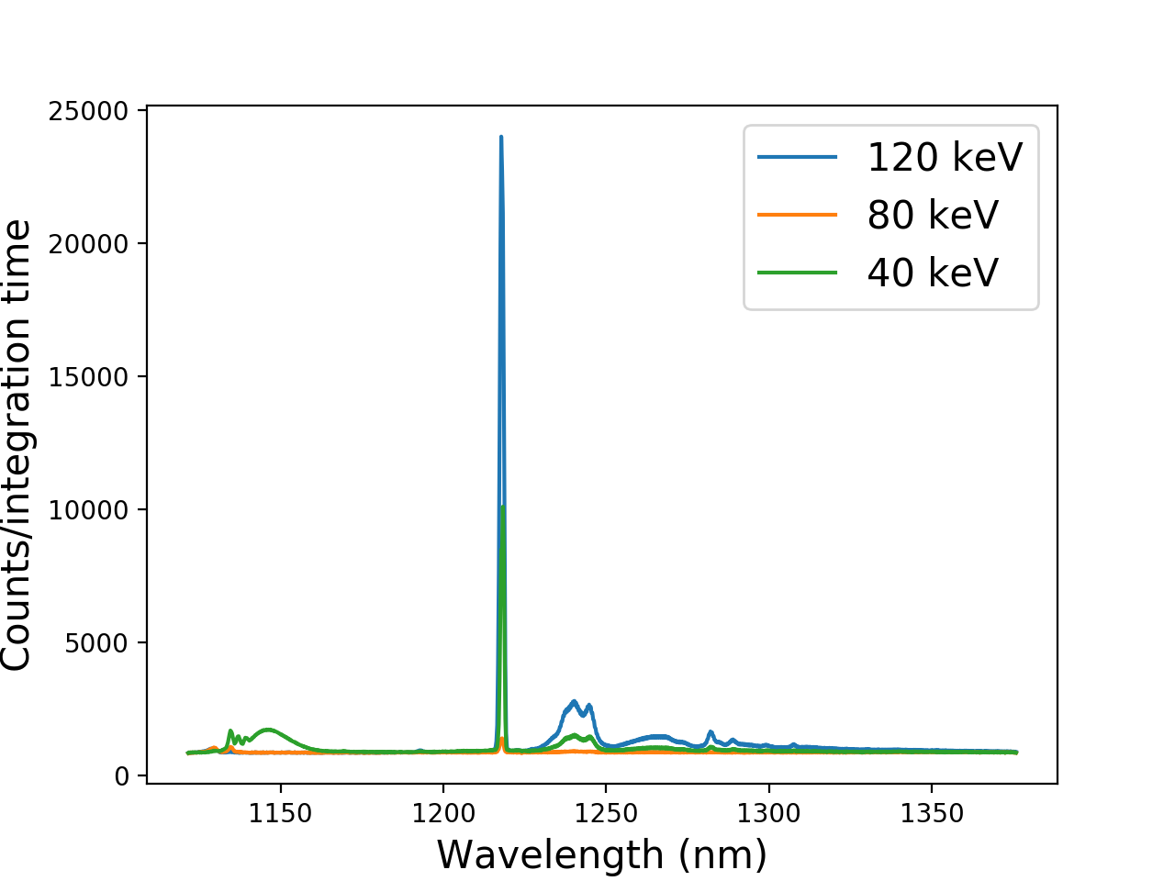
Light sources on 300-mm wafers
Photoluminescence of W centers in Si at 4 K
Fabricated at SUNY Poly by Pops Papa Rao and team
Measured at NIST by our team

Slide 61
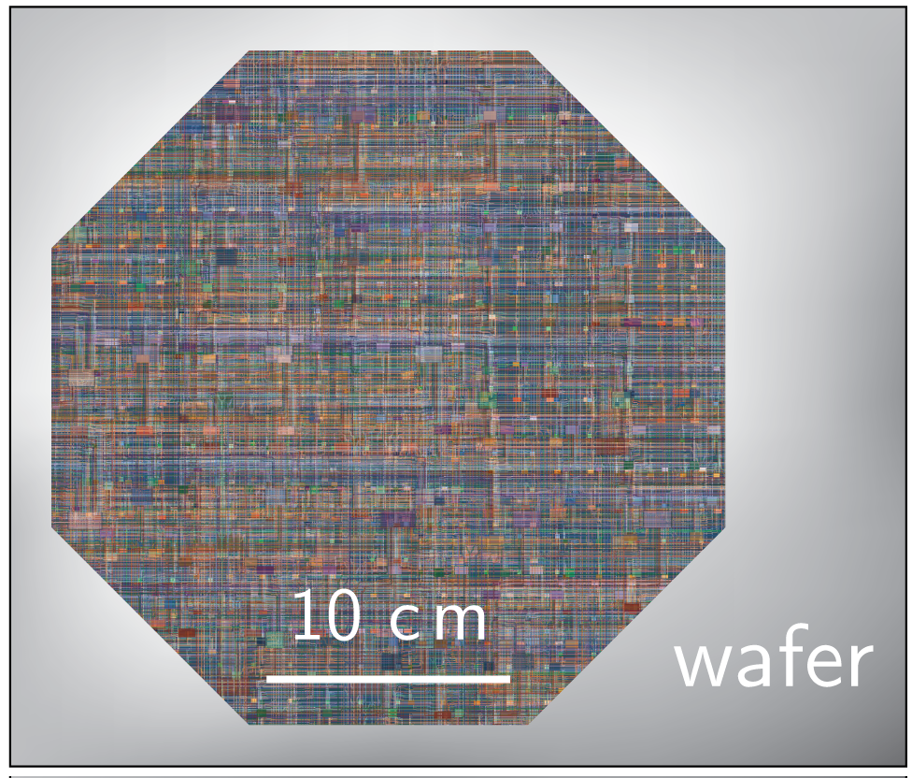
Wafer-scale modules

Slide 62
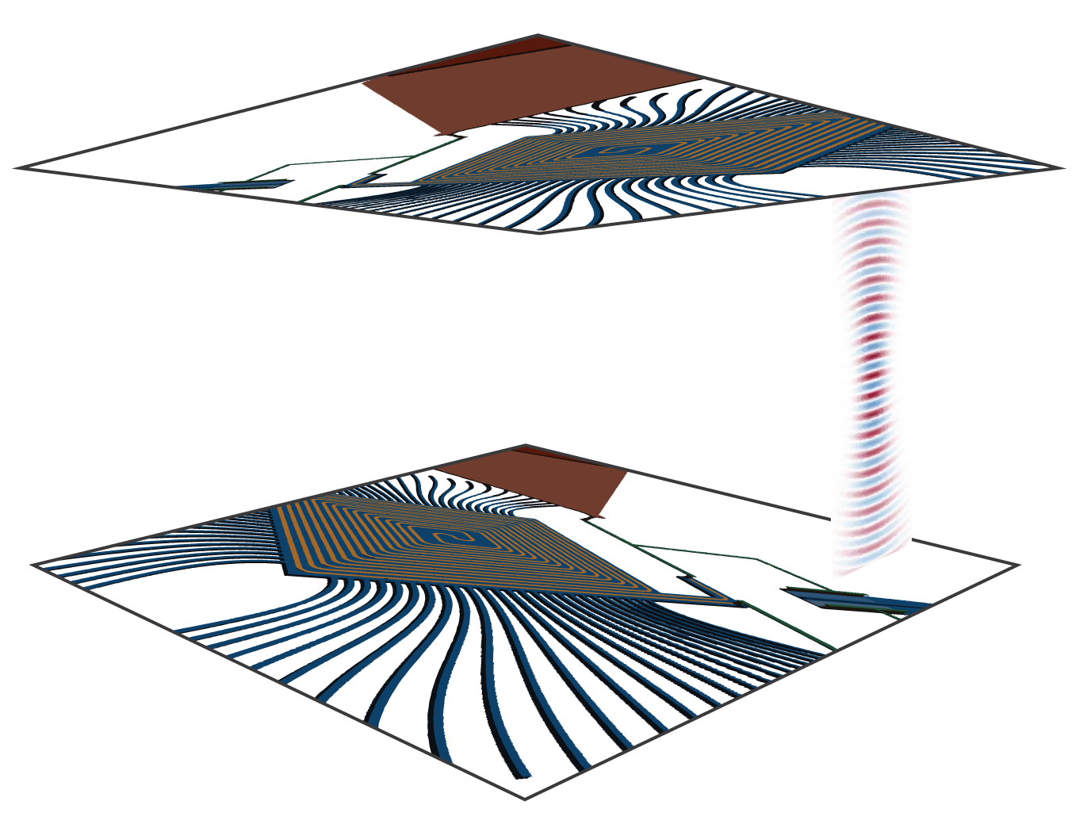
Free-space interconnects for 3D

Slide 63

Free-space inter-wafer interconnects

Slide 64

Multi-wafer modules

Slide 65

Brain-scale systems?
> 100 Billion neurons

Slide 66


What can we do in five years?
Artificial visual cortex

Slide 67
Superconducting
optoelectronic
networks
Dense local fan-out with photonics
Long-range communication at light speed
Computing and memory with superconducting electronics
Would this reach the limits of cognition?

Slide 69
Summary
Low Temperature Devices have the potential to be important in super-neuromorphic computing
Light for communication
Superconductors for computation
Complex neuro circuits
Can we get to a size scale for “Cognitive” Systems?

Slide 70

NIST team
Rich Mirin
Jeff Shainline
Sonia Buckley
Adam McCaughan
Alex Tait
Jeff Chiles
Saeed Khan
Krister Shalm
Marty Stevens
Adriana Lita
Varun Verma
Nima Nader
Mike Mazurek
Dileep Reddy
Eric Stanton
Galen Moody
Kevin Silverman
Thomas Gerrits
saewoo.nam@nist.gov
MIT, JPL, Suny-Poly
Boulder Labs

Slide 71

Cryogenic sensors

Slide 72

Collider readout

Slide 73

Genetic analysis

Slide 74

Neuroscience

Slide 75

Traffic networks

Slide 76

Data centers

Slide 77

Quantum interface

Slide 78


Quantum-neural hybrid systems
Quantum systems:
Inherently probabilistic
Quantum computing statistical
Entanglement fragile
Difficult to scale
Neural systems:
Sample probability distributions
Perform Bayesian inference
Spiking information robust
Highly scalable
What can a neural system know about a quantum system?

Slide 79

Structure of a Biological Neuron
From:Wikipedia
http://spie.org/news/5681-dendritic-plateau-potentials-modulate-neuronal-function?SSO=1

Slide 80
b
w₁
x₁
inputs
w₂
Σ
x₂
F(x)
w₃
x₃
Synaptic
Weights
Summing
Node
Activation
Function

Slide 81

Supervised Learning
Use “labeled” data to determine weights and biases in a neural network
Make “inferences” on new inputs
https://abeyon.com/how-do-machines-learn/

Slide 83

https://towardsdatascience.com/spiking-neural-networks-the-next-generation-of-machine-learning-84e167f4eb2b

Slide 84

The synapse

Slide 85


Slide 86


Slide 87

McCaughan et al., “A Superconducting-Nanowire Three-Terminal Electrothermal Device”, Nano Lett. (2014)

Slide 88


Slide 89

McCaughan et al., in preparation

Slide 91
Requirements for light sources
Incoherent pulses
~10,000 photons per pulse (fJ)
Efficiency of 10⁻³
20 MHz
4.2 K

Slide 92



The basic SOEN neuron
SNSPD
input
Cryotron
Switch
SNSPD
Silicon LED
output
input
1 photon
1 mV
1 V
10,000 photons
Optical
Electronic
Optical
J. M. Shainline, S. M. Buckley, R. P. Mirin, and S. W. Nam, “Superconducting optoelectronic circuits for neuromorphic computing,” Phys. Rev. Applied, Mar 2017.
Notes:
Point about O/E/O
Optical nonlinerity would need a ton of power
Summing in the electronic domain
We have shown these things separately. We are working now on co-integration

Slide 93




Co-integration: waveguides + SNSPDs
1 um
J. Shainline et al. ” Room-temperature-deposited dielectrics and superconductors for...” Op. Ex., 2017.
Notes:
No dark counts
High yield
Photonic routing

Slide 94
Recap: The basic SOEN neuron
SNSPD
input
Cryotron
Switch
SNSPD
Silicon LED
output
input
1 photon
1 mV
1 V
10,000 photons
Optical
Electronic
Optical
J. M. Shainline, S. M. Buckley, R. P. Mirin, and S. W. Nam, “Superconducting optoelectronic circuits for neuromorphic computing,” Phys. Rev. Applied, Mar 2017.
Notes:
Point about O/E/O
Optical nonlinerity would need a ton of power
Summing in the electronic domain
We have shown these things separately. We are working now on co-integration

Slide 95

Fluxonic processing
Inductive coupling
to LED
Flux induced in the next junction
Flux induced by excitatory SNSPDs
Weighted sum of incoming fluxes
Flux induced by inhibitory SNSPD
J. M. Shainline, “Fluxonic processing of photonic synapse events,” arXiv:1904.02807, 2019.
Notes:
Fan-in
Cascadability
Programmability

Slide 96
Fluxonic processing
Inductive coupling
Flux induced in the next junction
Flux induced by excitatory SNSPDs
Weighted sum of incoming fluxes
Flux induced by inhibitory SNSPD
J. M. Shainline, “Fluxonic processing of photonic synapse events,” arXiv:1904.02807, 2019.
Notes:
Fan-in
Cascadability
Programmability

Slide 97


Camera Measurements
Single fiber input
Measure many ports
Grating
couplers
View through camera
Optical Fiber

Slide 98


Sources + detectors + readout → generic testbed
Your Circuit Here
Silicon LED
SNSPDs
Superconducting
switches
Public multi-project wafer (MPW) offering is planned
We are looking for collaborators on MPW pre-pilot runs
Need experimental capabilities and application ideas (esp. in quantum)
More info pages.nist.gov/SOEN-PDK
Contact jeffrey.shainline@nist.gov, alexander.tait@nist.gov
S. Papa Rao. “Progress Towards Enabling Quantum Engineering.” PfQ Workshop, RIT, Jan. 2019.
http://ridl.cfd.rit.edu/products/talks/PfQ/Friday/PfQ%20Pops.pdf
Notes:
Part of NISTs mission is to promote innovation and industry,
not just through our research but by enabling others to do their research

Slide 99

Path to full integration at large scales
SUNY Poly for process at 300 mm scale

Slide 100
Summary
Foundry silicon photonics enables new concepts in information processing now
The SOEN proposal
What are the physical limits to large-scale neuromorphic systems
Recent co-integration results
SNSPDs
All-silicon LEDs
Superconducting switches
Multi-planar waveguides
Fluxonic circuitry
Cryogenic silicon photonics MPW

Slide 101
Can’t we do all this at room temperature?
Yes, but
Source efficiency improves 100x at 4 K
Detector efficiency improves 100x at 4 K
Superconducting circuits excel at neuro
Communicate to 300 K with 1 eV photons
Quantum-neural hybrid computing

Slide 102
Why neurons?
Energy efficient
Tunable frequency response
Resilient to noise
Information in rate and correlations

Slide 103

Synaptic transducer

Slide 104


Slide 105
Lowest light level
(hν = 1.3 x 10⁻¹⁹ J)

Slide 106
Lowest light level
Zero static power

Slide 107


Synaptic transducer

Slide 108

Synaptic transducer

Slide 109

Synaptic transducer

Slide 110
Synaptic transducer
Synaptic bias current

Slide 111

Dendritic processing
Coincidence detection

Slide 112

Dendritic processing
Sequence detection

Slide 113

Dendritic processing
Nonlinear processing

Slide 114

Transmitters

Slide 115

Waveguide-coupled electroluminescence from silicon
To taper
W-center emission

Slide 116
Emitters integrated with single-photon detectors
Buckley et al, APL 111 141101 (2017).

Slide 117
Requirements for light sources
Incoherent pulses
10,000 photons per pulse (fJ)
Efficiency of 10⁻³
20 MHz
4.2 K
Should be pretty easy

Slide 118
How do we implement photonic networks?

Slide 119
First steps toward photonic networks
Three planes of amorphous silicon waveguides
Chiles et al., APL Photonics 2, 116101 (2017)

Slide 120
Inter-planar couplers
0.05 dB loss
36 μm length
36 μm
Chiles et al, APL Photonics 2 116101 (2017).

Slide 121
10 x 100 routing couplers
Chiles et al, APL Photonics 3 106101 (2018).

Slide 122

Core device
Tap and transition

Slide 123


10 x 100 routing couplers

Slide 124
10 x 100 routing couplers

Slide 125
10 x 100 routing couplers

Slide 126
10 x 100 routing couplers

Slide 127


10 x 100 routing couplers

Slide 128
Camera Measurements
Single fiber input
Measure many ports
Grating
couplers
View through camera
Optical Fiber

Slide 129

Camera Measurements
Analogous to MRI
Volume imaging of 3D assemblies
Grating
couplers
View through camera
Optical Fiber

Slide 130

Further scaling to 3D

Slide 131

Waveguide routing architecture

Slide 132

Waveguide routing architecture

Slide 133


Calculate the area:
1 cm x 1 cm die: 8100 neurons + 300,000 synapses
300 mm wafer: 1 million neurons + 200 million synapses

Slide 134
Calculate the area:
1 cm x 1 cm die: 8100 neurons + 300,000 synapses
300 mm wafer: 1 million neurons + 200 million synapses

Slide 135
Cognitive Systems:
Differentiated local processing
Information integration across:
Space (network structure)
Time (dynamics)
Experience (plasticity)

Slide 136
Cognitive Systems:
Differentiated local processing
Information integration across:
Space (network structure)
Time (dynamics)
Experience (plasticity)

Slide 137

Time and space intertwined
High-frequency oscillations synchronize local sectors

Slide 138
Time and space intertwined
High-frequency oscillations synchronize local sectors
Mid-frequency oscillations synchronize regions

Slide 139

Time and space intertwined
High-frequency oscillations synchronize local sectors
Mid-frequency oscillations synchronize regions
Low-frequency oscillations synchronize the system

Slide 140
Time and space intertwined
Need neurons that can oscillate across many frequencies

Slide 141
Time and space intertwined
Need neurons that can oscillate across many frequencies
Brain: up to 600 Hz

Slide 142
Time and space intertwined
Need neurons that can oscillate across many frequencies
Brain: up to 600 Hz
Loop neurons: up to 20 MHz

Slide 143
Time and space intertwined
What if you could think 30,000 times faster?

Slide 144

Synaptic update

Slide 145
Synaptic plasticity
Adaptive memory at each synapse

Slide 146

Supervised learning

Slide 147

Supervised learning
Analog synaptic weights

Slide 148

Unsupervised learning
Two photons for spike-timing dependent plasticity
Complex circuit functionality
Weighting in the superconducting domain conserves photons

Slide 149

Other plasticity mechanisms
Short-term plasticity

Slide 150

Other plasticity mechanisms
Homeostatic
plasticity

Slide 151

Other plasticity mechanisms
Metaplasticity

Slide 152
Weaknesses:

Slide 153


Process development
NIST cleanroom for near-term results
3”

Slide 154
Process development
NIST cleanroom for near-term results
SUNY Poly for development of optoelectronic process at 300 mm scale

Slide 155
NIST should share their process

Slide 156
NIST should share their process
We agree.

Slide 157
NIST should share their process
We agree. We’re working on it.

Slide 158

NIST should share their process
Silicon light sources, single-photon detectors, passive dielectric waveguides

Slide 159
NIST should share their process
Process design kit and multi-project wafers, hopefully 2019
let me know if you’re interested
jeffrey.shainline@nist.gov

Slide 160
Weaknesses:
Requires process development
Cryogenic operation

Slide 161
Weaknesses:
Requires process development
Cryogenic operation

Slide 162
Weaknesses:
Requires process development
Cryogenic operation
(minor inconvenience)

Slide 163

Can you find the fridge?

Slide 164
Can you find the fridge?

Slide 165

Ultimate scaling limits

Slide 166

Ultimate scaling limits
Number of neurons capable of synchronizing

Slide 167

The neuronal pool
Number of neurons capable of synchronizing

Slide 168
Very large cognitive systems
10¹⁰ times the number of synapses as the brain
Operating 30,000 times faster

Slide 169

Superconducting optoelectronic networks
Light for communication
Superconductors for computation
Complex neuro circuits
arXiv:1805.01929
arXiv:1805.01947
jeffrey.shainline@nist.gov

Slide 170

Quantum-neural hybrid computing

Slide 171
Can’t we do all this at room temperature?
Yes, but
Source efficiency improves 100x at 4 K
Detector efficiency improves 100x at 4 K
Superconducting circuits excel at neuro
Communicate to 300 K with 1 eV photons
Quantum-neural hybrid computing

Slide 172
Why neurons?
Energy efficient
Tunable frequency response
Resilient to noise
Information in rate and correlations

